Slide 1
The Response of Ocean Skin Temperature to Rain
Observations and Implications for Parameterization of Rain-Induced Fluxes
Carson R. Witte
with co-authors Christopher J. Zappa
and James B. Edson
Witte, C. R., Zappa, C. J., & Edson, J. B. (2023).
The Response of Ocean Skin Temperature to Rain: Observations and Implications for Parameterization of Rain-Induced Fluxes.
Journal of Geophysical Research: Oceans, 128(1), e2022JC019146. https://doi.org/10.1029/2022JC019146

Slide 2
rain is near atmospheric wet bulb temperature – almost always colder than the ocean
stable cool fresh surface layer
rain is freshwater – dominant buoyancy effect
C. Witte

Slide 3
ocean skin
mm layer where molecular conduction dominates
ocean is usually losing heat to the atmosphere – cool skin
intermittently disrupted, reforms in a few seconds
rain is near atmospheric wet bulb temperature – almost always colder than the ocean
stable cool fresh surface layer
rain is freshwater – dominant buoyancy effect
C. Witte
Notes:
We have novel observations of the ocean skin during rain events that we’re going to dig into here
First need to define the skin

Slide 4
large drops
rain is near atmospheric wet bulb temperature – almost always colder than the ocean
stable cool fresh surface layer
rain is freshwater – dominant buoyancy effect
C. Witte
Notes:
When it comes to rain, large drops break the skin layer and cause turbulent renewals on a scale similar to microbreakers

Slide 5
small drops
rain is near atmospheric wet bulb temperature – almost always colder than the ocean
stable cool fresh surface layer
rain is freshwater – dominant buoyancy effect
C. Witte
Notes:
Small drops fall slowly and can’t break the surface tension – accumulate in the skin

Slide 6
Rain Event Imagery
R/V Falkor, 2016
C. Witte
Notes:
To help contextualize this, we’ll look at some imagery taken by these cameras of a rain event

Slide 7
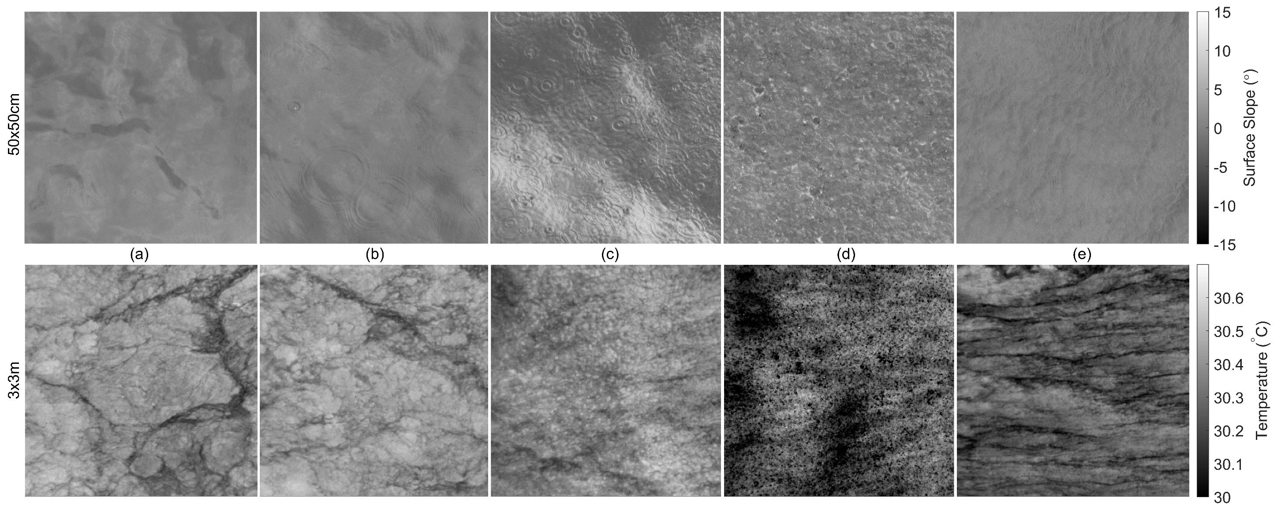
Rain Event Imagery
R/V Falkor, 2016
polarimetry
Before Rain
Light Rain (<10mm/hr)
Heavy Rain (~40mm/hr)
Extreme Rain (>100mm/hr)
After Rain
infrared
Witte, C. R., Zappa, C. J., & Edson, J. B. (2023). The Response of Ocean Skin Temperature to Rain: Observations and Implications for Parameterization of Rain-Induced Fluxes. Journal of Geophysical Research: Oceans, 128(1), e2022JC019146. https://doi.org/10.1029/2022JC019146
Notes:
Top row is polarimetry - visible imagery with quantitative measurement of the surface slope
Bottom row is infrared – temperature of the skin layer
Ring waves
Impact craters
Surface renewals
Chaos
Cooling

Slide 8
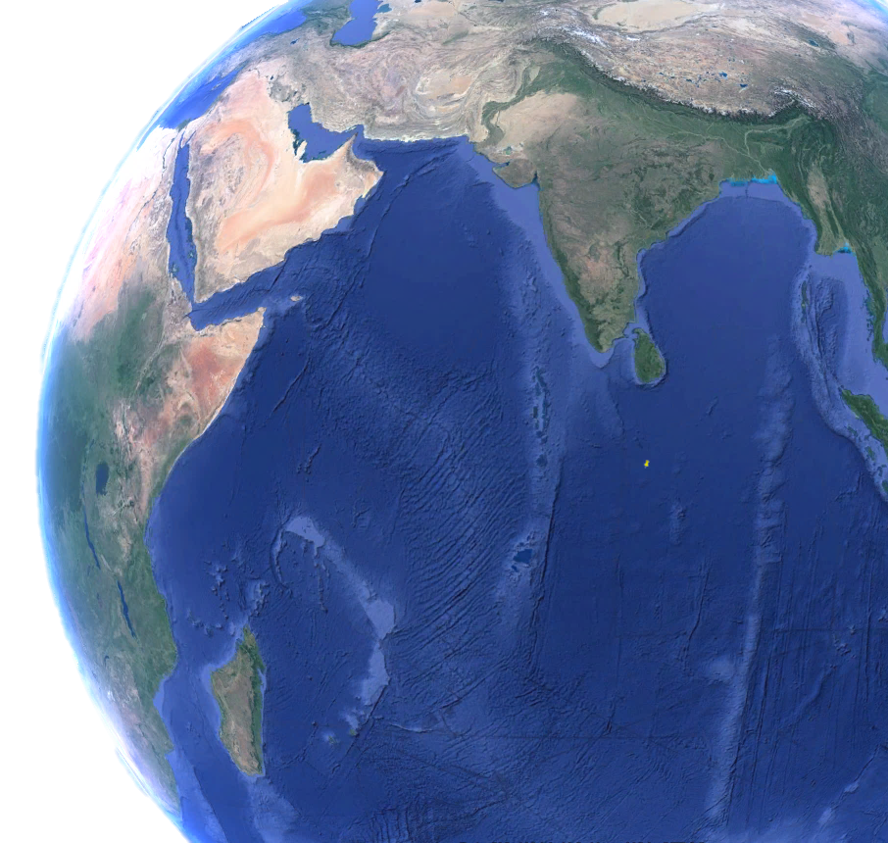
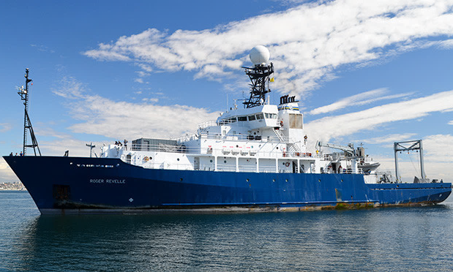
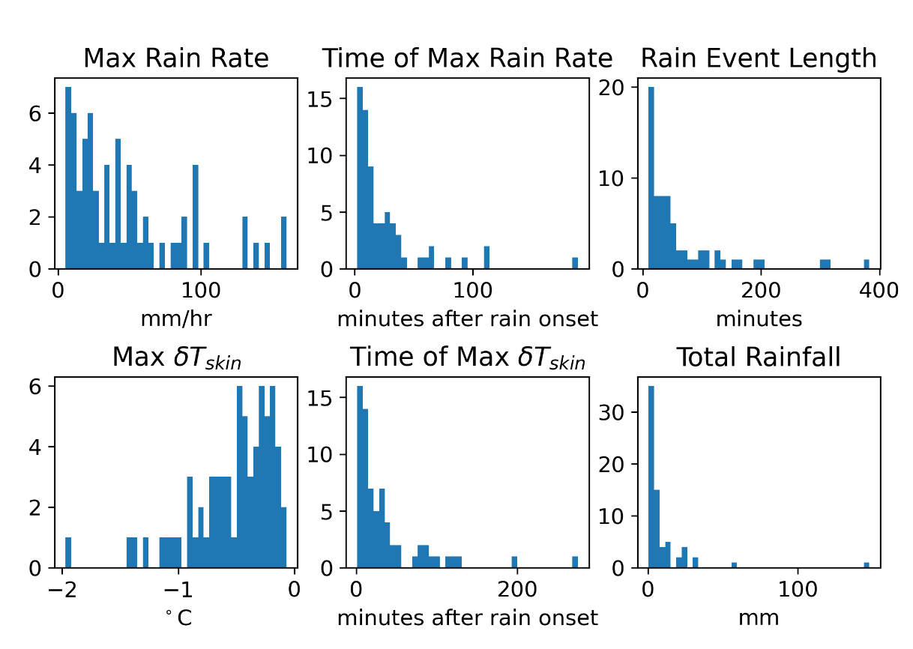
Skin Temperature Dataset
R/V Revelle, DYNAMO experiment
Rain Gauge
0°N, 80.5°E
Sea Snake
IR Radiometers
4 Months
69 Rain Events
Witte, C. R., Zappa, C. J., & Edson, J. B. (2023). The Response of Ocean Skin Temperature to Rain: Observations and Implications for Parameterization of Rain-Induced Fluxes. Journal of Geophysical Research: Oceans, 128(1), e2022JC019146. https://doi.org/10.1029/2022JC019146
Notes:
Radiometric skin temperature from R/V Revelle throughout 69 rain events
Along with rain rate, 5cm temperature, and the typical suite of bulk atmospheric measurements.
Rain events were generally less than an hour long, with a maximum rain rate below 100 mm/hr and maximum decrease in skin temperature between 0 and 1 degrees Celsius.

Slide 9
Composite of Rain Events
Normalized Timescale
Witte, C. R., Zappa, C. J., & Edson, J. B. (2023). The Response of Ocean Skin Temperature to Rain: Observations and Implications for Parameterization of Rain-Induced Fluxes. Journal of Geophysical Research: Oceans, 128(1), e2022JC019146. https://doi.org/10.1029/2022JC019146
Notes:
Skin temp decreases by 4/10ths of a degree on average
5cm temp decreases by only 1/10th, 5m barely registers
Sensible heat flux due to deposition of colder water averages more than 100 W/m^2
can be over 50% of the net heat flux during rain,
and 2-15% of the net long-term heat flux in heavy precipitation regions

Slide 10
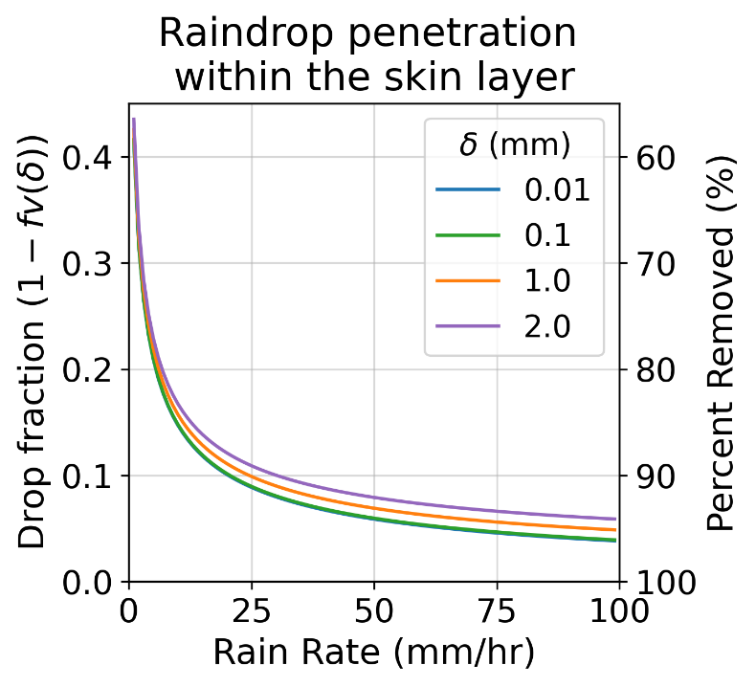
Skin Temperature Model
Bellenger et al. (2017)
start from 1-D heat transfer equation:
adding rain effects:
tangential stress
rain mixing
$$u_{∗w}={\left[\frac{1}{ρ_{w}}\left(τ_{wind}+\left(1−f_{V}\left(δ\right)\right)τ_{rain}+\left(f_{V}\left(0\right)−f_{V}\left(δ\right)\right)τ_{k}\right)\right]}^{1/2}$$
$$\frac{∂T}{∂t}=\frac{∂}{∂z}\left(K_{w}+k_{w}\right)\frac{∂T}{∂z}+\frac{1}{ρ_{w}c_{w}}\frac{∂I_{S}}{∂z}$$
(molecular processes dominate)
$$Q=I_{L}+Q_{Lat}+Q_{Sens}+Q_{Rain} \left(1−f_{V}\left(δ\right)\right)$$
boundary condition at z = 0:
$ρ_{w}c_{w}k_{w}\frac{∂T}{∂z}=Q$
surface heat flux
sensible heat from rain
(Gosnell et al., 1995):
integrating with depth yields:
$$T_{skin}−T_{subskin}= \frac{δ}{ρ_{w}c_{w}k_{w}}\left(Q+I_{S}f_{S}\left(δ\right)\right)$$
$$Q_{Rain}=−c_{w}RΔTε\left(1+B^{−1}\right)$$
$$δ\left(u_{∗w},Q_{b}\right)=$$
thickness of the skin layer
rain rate
air-sea temperature difference
buoyancy flux
friction velocity
Bellenger, H., Drushka, K., Asher, W., Reverdin, G., Katsumata, M., & Watanabe, M. (2017). Extension of the prognostic model of sea surface temperature to rain-induced cool and fresh lenses. Journal of Geophysical Research: Oceans, 122(1), 484–507. doi:10.1002/2016JC012429
Notes:
Going to use our observations to test a skin temperature model derived by Bellenger et al., 2017,
Previously tested against observations of the sub-skin layer during rain and performed accurately.
Never been tested against skin-layer observations until now.
(talk through derivation...)
Makes sense to scale turbulent effects in the skin layer by the initial penetration depth of the raindrops
But it may not be physically realistic to scale the sensible heat flux of the rain by initial penetration depth, given both
rain-driven increase in surface renewals and
buoyancy of the raindrop remnants after initial impact.
As you can see on this graph, this scaling term serves to remove 80-90% of the rain sensible heat flux from the budget of the skin layer even at modest rain rates. We will therefore test two model options:

Slide 11
Skin Temperature Model
Bellenger et al. (2017)
start from 1-D heat transfer equation:
adding rain effects:
tangential stress
rain mixing
$$u_{∗w}={\left[\frac{1}{ρ_{w}}\left(τ_{wind}+\left(1−f_{V}\left(δ\right)\right)τ_{rain}+\left(f_{V}\left(0\right)−f_{V}\left(δ\right)\right)τ_{k}\right)\right]}^{1/2}$$
$$\frac{∂T}{∂t}=\frac{∂}{∂z}\left(K_{w}+k_{w}\right)\frac{∂T}{∂z}+\frac{1}{ρ_{w}c_{w}}\frac{∂I_{S}}{∂z}$$
(molecular processes dominate)
$$Q=I_{L}+Q_{Lat}+Q_{Sens}+Q_{Rain} \left(1−f_{V}\left(δ\right)\right)$$
boundary condition at z = 0:
Testing 2 Model Options:
“Original” includes this term
“Modified” removes this term
$ρ_{w}c_{w}k_{w}\frac{∂T}{∂z}=Q$
surface heat flux
sensible heat from rain
(Gosnell et al., 1995):
integrating with depth yields:
$$T_{skin}−T_{subskin}= \frac{δ}{ρ_{w}c_{w}k_{w}}\left(Q+I_{S}f_{S}\left(δ\right)\right)$$
$$Q_{Rain}=−c_{w}RΔTε\left(1+B^{−1}\right)$$
$$δ\left(u_{∗w},Q_{b}\right)=$$
thickness of the skin layer
rain rate
air-sea temperature difference
buoyancy flux
friction velocity
Bellenger, H., Drushka, K., Asher, W., Reverdin, G., Katsumata, M., & Watanabe, M. (2017). Extension of the prognostic model of sea surface temperature to rain-induced cool and fresh lenses. Journal of Geophysical Research: Oceans, 122(1), 484–507. doi:10.1002/2016JC012429

Slide 12
Model Evaluation
Bellenger et al. (2017)
“Original Model”
scales rain sensible heat by $\left(1−f_{V}\left(δ\right)\right)$
“Modified Model”
includes full rain sensible heat term
Model – Observed (°C)
rain sensible heat term is crucial
Rain Rate (mm/hr)
Rain Rate (mm/hr)
Systematically over-predicts $T_{skin}$ with increasing rain rate
Consistent with observations below ~100mm/hr
Witte, C. R., Zappa, C. J., & Edson, J. B. (2023). The Response of Ocean Skin Temperature to Rain: Observations and Implications for Parameterization of Rain-Induced Fluxes. Journal of Geophysical Research: Oceans, 128(1), e2022JC019146. https://doi.org/10.1029/2022JC019146
Notes:
Comparing the model results to the observations at every timestep across every rain event, each plotted as a dot on these figures
Original model systematically over-predicts the skin temperature
Modified model performs much better, displays little trend with rain rate except for the really extreme cases
So including the whole rain sensible heat term is critical, and indeed...

Slide 13
Model Evaluation
COARE 3.5
Base COARE3.5
no rain physics
“Modified” COARE3.5
includes rain sensible heat term
Model – Observed (°C)
this modification is being used!
currently in CESM2, soon in GISS GCM
Rain Rate (mm/hr)
Rain Rate (mm/hr)
Systematically over-predicts $T_{skin}$ with increasing rain rate
Consistent with observations below ~50mm/hr
Witte, C. R., Zappa, C. J., & Edson, J. B. (2023). The Response of Ocean Skin Temperature to Rain: Observations and Implications for Parameterization of Rain-Induced Fluxes. Journal of Geophysical Research: Oceans, 128(1), e2022JC019146. https://doi.org/10.1029/2022JC019146
Notes:
Take the standard COARE3.5 air-sea interaction model, not set up to include any rain physics, and just add the rain sensible heat term into its heat budget...
Performs almost as well as our modified model from the previous slide, especially below 50mm/hr.
Conclusion: sensible heat due to rain is dominant effect on skin temperature, other effects are second-order
Just adding rain sensible heat is a simple enough modification that it is actually being used!

Slide 14
Wind Influence
Typical value of cool-skin correction in winds > 6 m/s
(Donlon et al., 2002)
Witte, C. R., Zappa, C. J., & Edson, J. B. (2023). The Response of Ocean Skin Temperature to Rain: Observations and Implications for Parameterization of Rain-Induced Fluxes. Journal of Geophysical Research: Oceans, 128(1), e2022JC019146. https://doi.org/10.1029/2022JC019146
Notes:
The persistence of the cold fresh rain layer on the ocean surface will be influenced by the amount of wind-driven mixing. Here we have plotted the maximum temperature decrease on the y-axis, binned by mean wind speed during the rain event on the x-axis.
As expected, we see larger decreases in both skin temperature and 5cm-deep temperature at lower wind speeds, and above 7 or 8 m/s the 5cm temperature decrease becomes very close to zero. However, there is always a decrease in skin temperature over the course of the rain events, even at the highest wind speeds observed.
Outside of rain events, the difference between skin and subskin temperature approaches a constant value above wind speeds of 6 m/s. The differences we see here are of a similar magnitude but consistently a bit larger, and so we emphasize that the typical value should not be applied while it is raining.

Slide 15
Skin – Bulk Temperature Difference
Witte, C. R., Zappa, C. J., & Edson, J. B. (2023). The Response of Ocean Skin Temperature to Rain: Observations and Implications for Parameterization of Rain-Induced Fluxes. Journal of Geophysical Research: Oceans, 128(1), e2022JC019146. https://doi.org/10.1029/2022JC019146
Notes:
Another interesting observation we made from this dataset was that the difference between the skin temperature and the 5m deep temperature seems to level off at higher rain rates
“above a rainfall rate in the vicinity of 30 mm h−1, increasing the rainfall rates may merely increase the frequency of ricocheting or spallation motions with negligible increase in deeply penetrating vertical droplet motions” (Peirson et al., 2013)

Slide 16
Take Home Messages
modified a model to reliably predict skin temperature during rain events
rain sensible heat is key
adding to surface heat budget captures most of the effect
model physics is ineffective at very high rain rates
C. Witte

