Slide 1
Status and evolution of EUMETSAT SST/IST Multi-Mission Matchup Database (MMDB) Igor Tomazic, Gary Corlett, Anne O’Carroll
EUMETSAT
ISFRN25 Workshop, 3-4th April, 2025

Slide 2
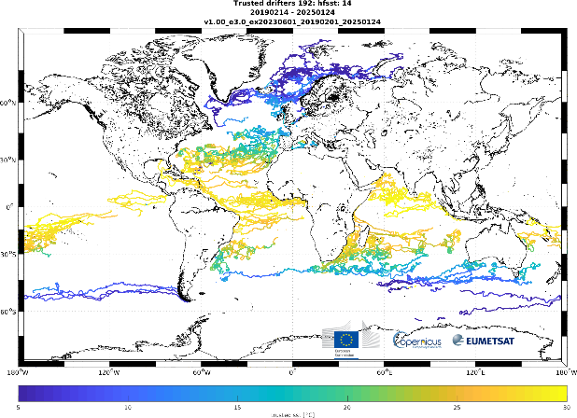
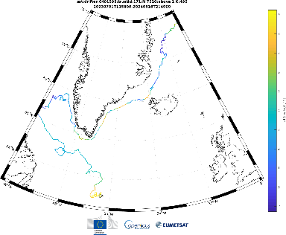
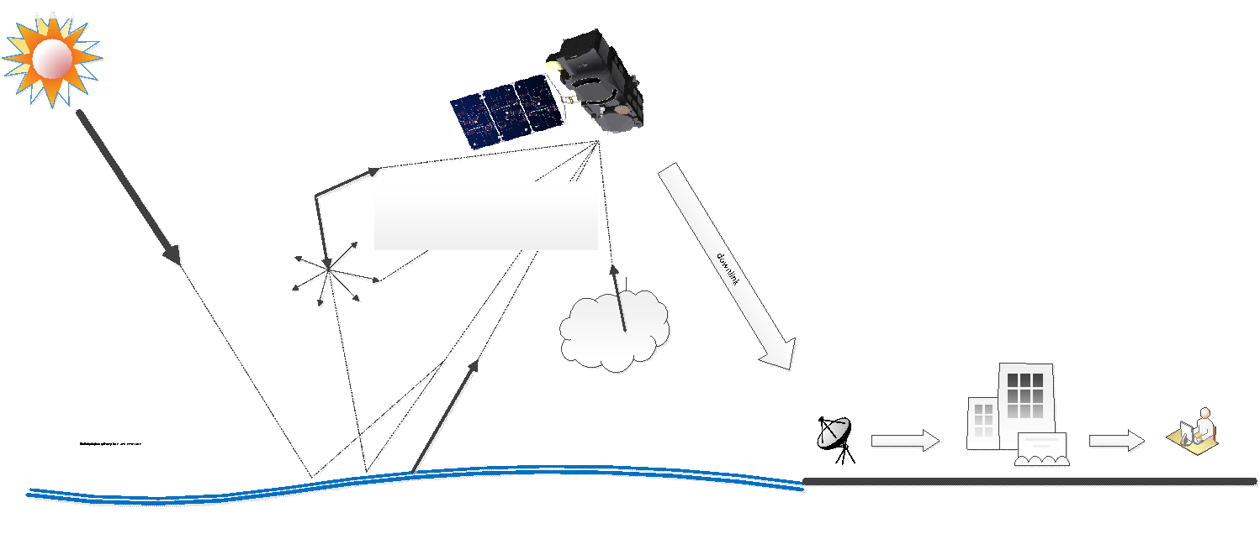
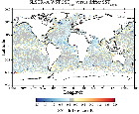
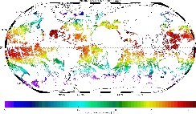
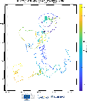
SST/IST (ST) validation: overview I
For reference SLSTR SST/IST mission:
SLSTR L2 SST/IST + full end-to-end (E2E) chain
Validation/monitoring chain
In situ instruments 🡪 measurement 🡪 products
Fiducial Reference Measurements (FRM): TRUSTED & Radiometers
Satellite 🡪 geophysical retrievals
Satellite products
Level 0 + Level 1 (impacting SST/IST)
Level 2 SST/IST
Level 3 SST/IST
Timeliness: NRT&NTC
Level 2 algorithms
SST/IST skin and SST depth retrievals
Cloud screening/surface classification
RT modeling
Uncertainties/traceability
Intercomparison with other missions (L4/model/MMDB)
Ground segment (GS)

Slide 3
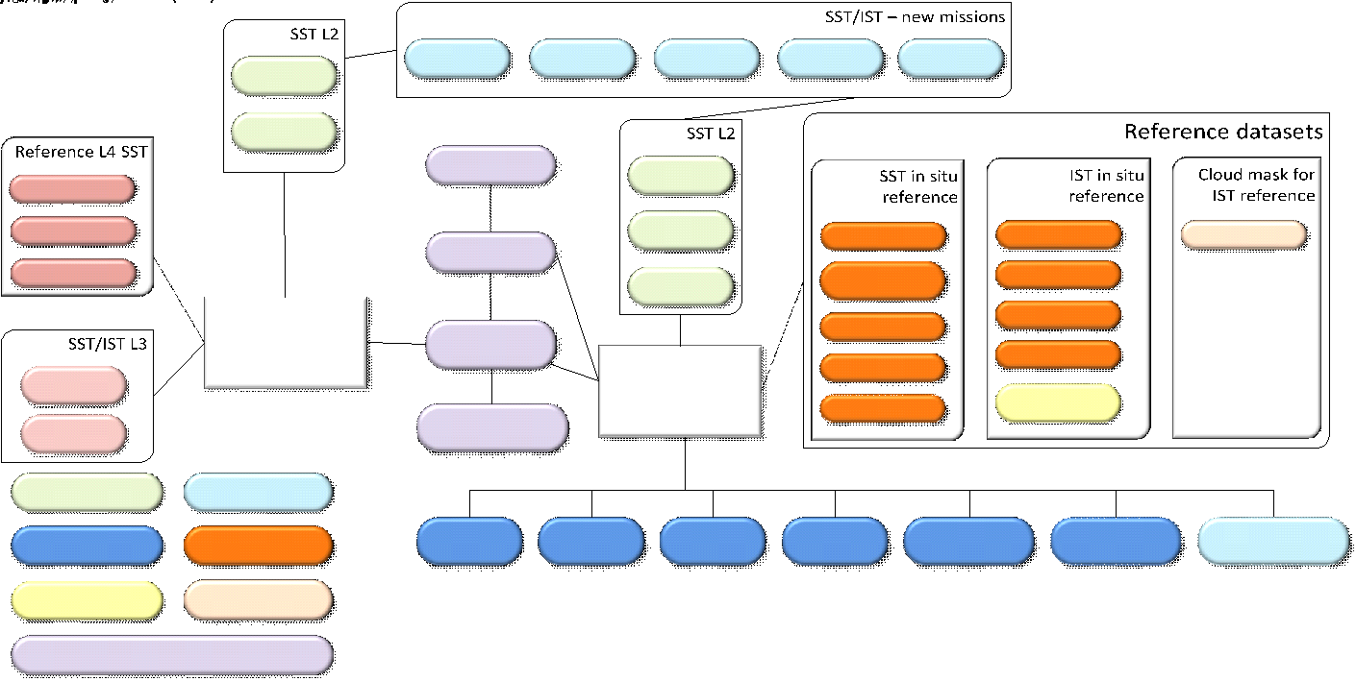
SST/IST validation: overview II

Slide 4
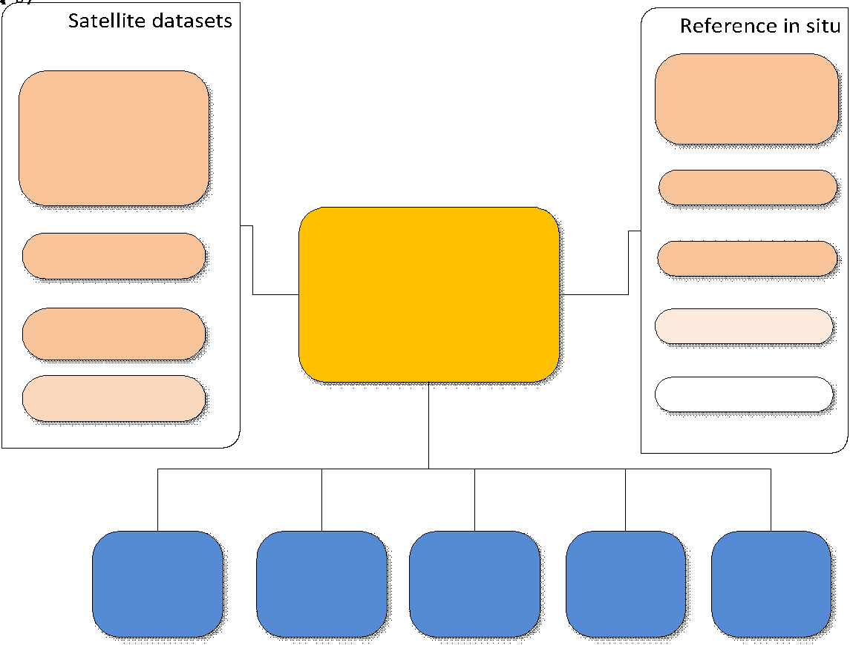
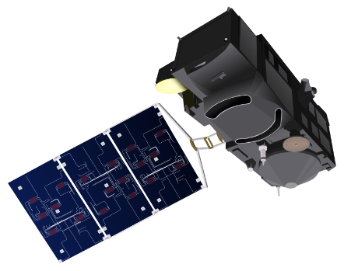
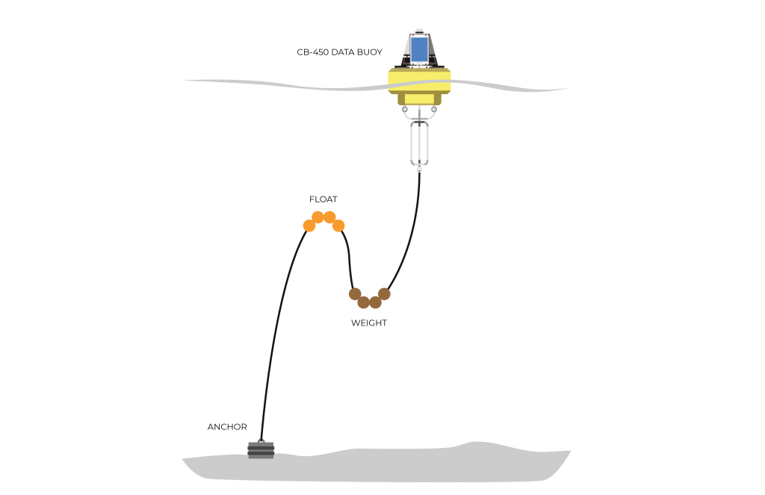
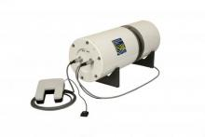
Cal/Val: SLSTR MMDB - status
Main component in SLSTR SST validation
Matchups between satellite and in situ data (felyx)
Satellite: SLSTR-A/B L1 RBT/L2 SST, AVHRR-B L2 SST, IASI-B L2 SST, VIIRS-NPP L2 SST
In situ: drifters, Argo, moored
FRM: TRUSTED, ship-borne Radiometers
Core file (L2:WST) plus aux (L2:WCT and L1:MET/RBT-i/RBT-a)
SLSTR MMDB access: sftp://s3calval.eumetsat.int
Available to Sentinel-3 Validation Team (S3VT)
To become S3VT member please submit proposal (s3vt.org) and request access to SLSTR MMDB

Slide 5
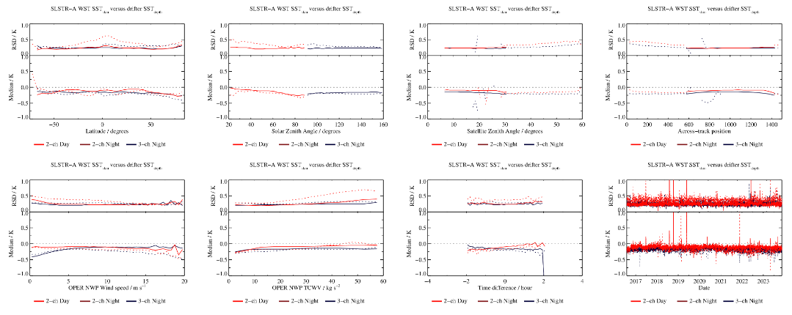
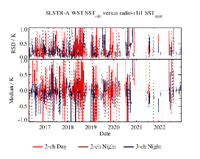
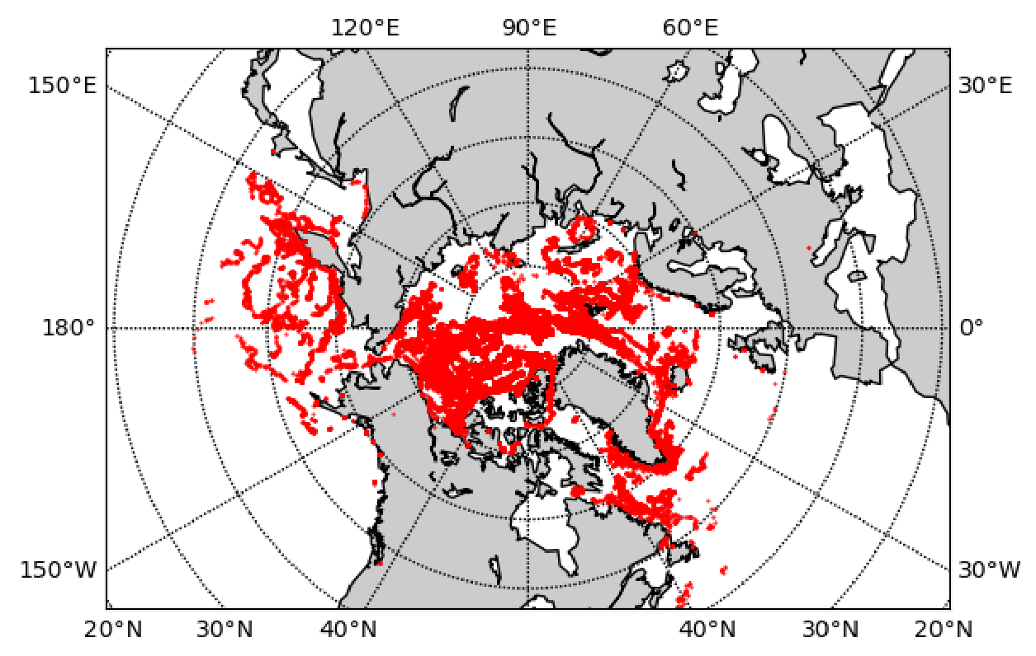
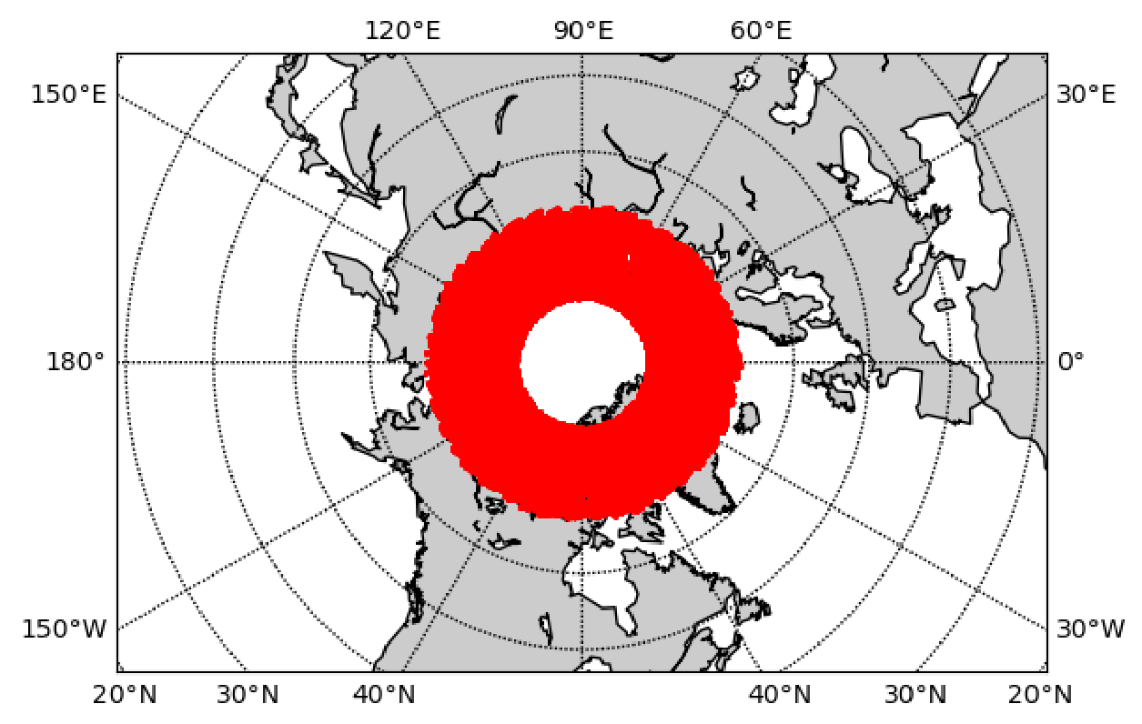
Cal/Val: SST/IST MMDB: current status
SLSTR SST (SST Baseline Collection 3):
Drifters/Argo/moored:
Repro (NTC) MMDB: 2016/04-2018/04 (SLSTR-A)
NRT MMDB: 2018/04 (SLSTR-A) 2019/03 (SLSTR-B) – onwards
TRUSTED
2019/02 – onwards
Radiometers
Repro MMDB: 2016/04-2018/04 (SLSTR-A NTC)
Offline MMDB: 2018/04-12/2022 (SLSTR-A/B NRT)
Completed: 01/2023-12/2024 (Q1 2025) (SLSTR-A/B NRT)
OSI-SAF AVHRR-B/IASI-B & NOAA VIIRS-NPP SST
Drifters/Argo/moored:
Similar time period
Internal usage (Cal/Val) but available per request
SLSTR IST (using new felyx2)
Reference
Cloud mask reference (CALIPSO/CALIOP)
In situ IST reference (PROMICE, IABP)
Satellite
2019 IST (demonstrational)
On going: 2018/05 – 2024/12: NH/SH S3A/S3B
SSTVAL internal tool with MMDB analysis results (missions, in situ types, quality levels, Met fields, …)

Slide 6
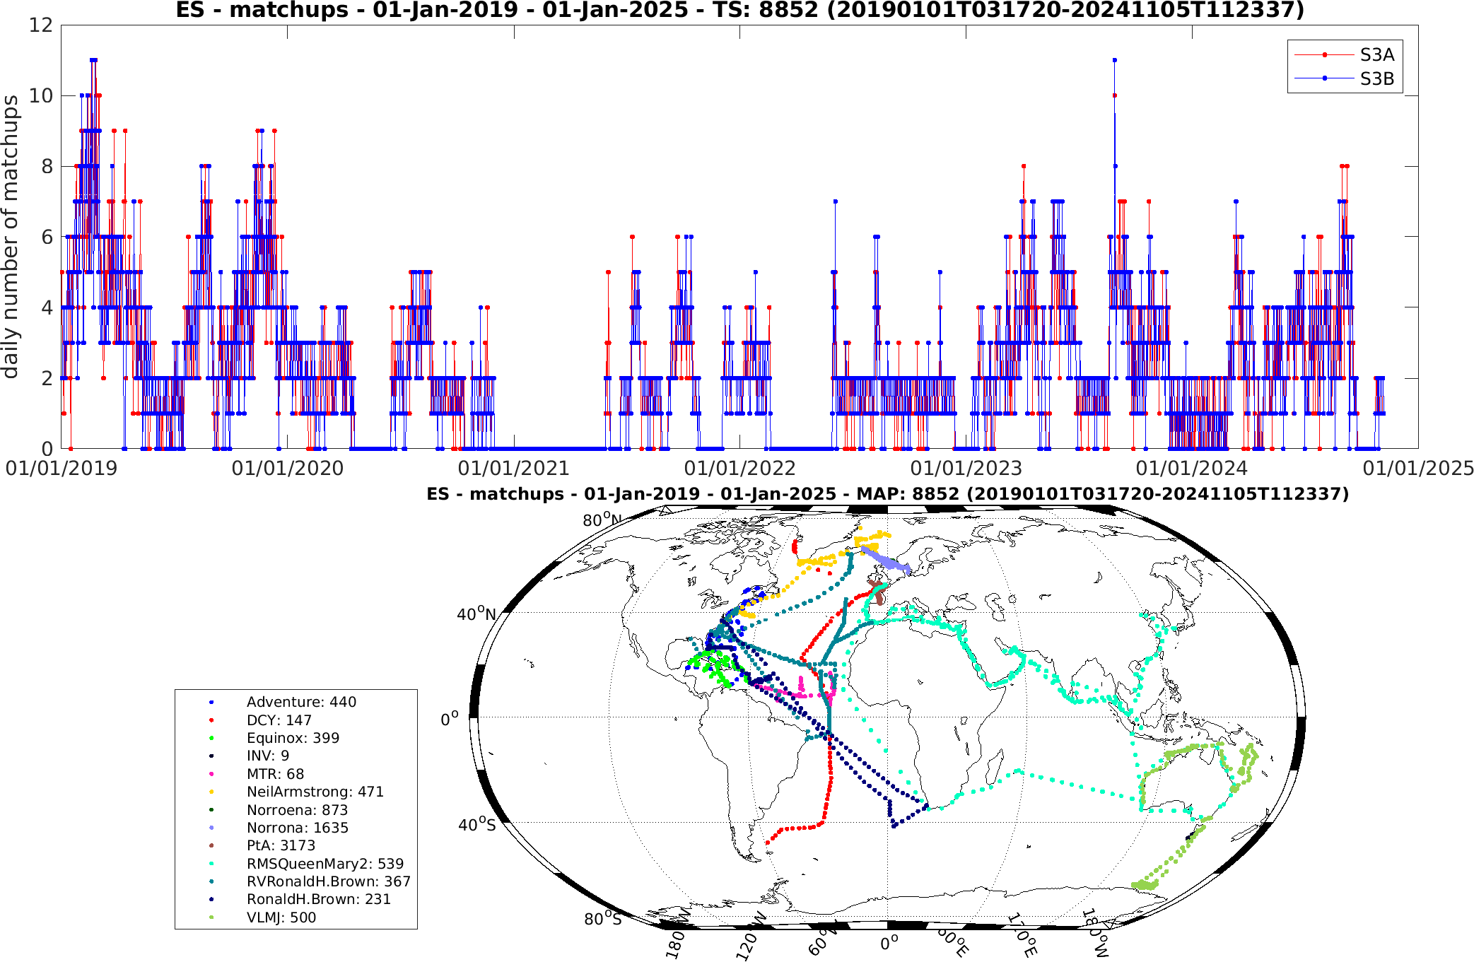
Radiometer SLSTR MMDB
Radiometer measurements
SLSTR-A/B vs. radiometer matchups (from 2019-onwards)

Slide 7
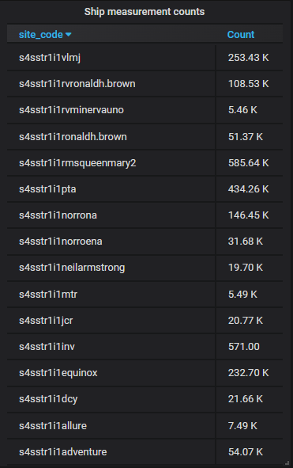
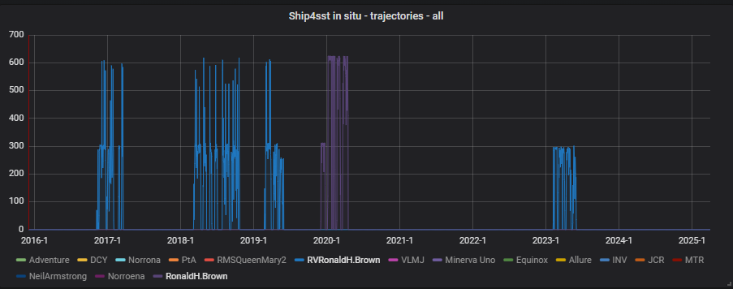
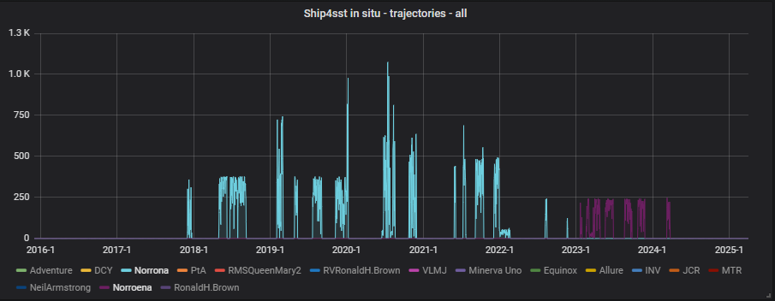
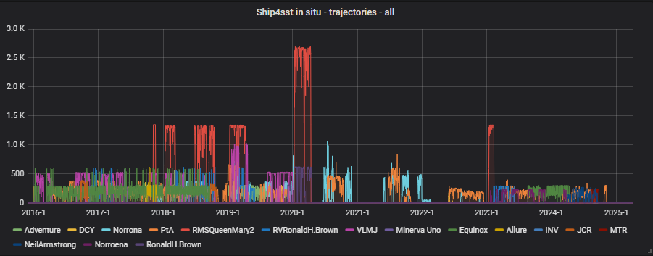
Radiometer SLSTR MDB

Slide 8
Radiometer MDB: suggested improvements
Improve directory structure:
Current structure: <INST>/<ORG>/<VER>/<YEAR>
Prone to errors when manually selecting the latest version for different instruments (as we saw now when QM2 is missing in 2023/2024 repro)
Suggestion: prepare <YEAR>/<MM> directory structure that includes only the single (latest) version of all radiometers within this month
<YEAR>/<MM>/<latest version of all radiometers>
Maintained by ISFRN project and updated every N months (e.g. twice per year as agreed before)
E.g. simple symbolic links pointing to data in original directory structure
Users will have to collect all relevant data only from yyyy/mm
Improve naming convention:

Slide 9
Cal/Val tools: Evolutions
Multimission Matchup DB 🡪 MMDB/felyx2
Performed within EUM Sci4MaST Copernicus project
https://www.eumetsat.int/Sci4MaST

Slide 10
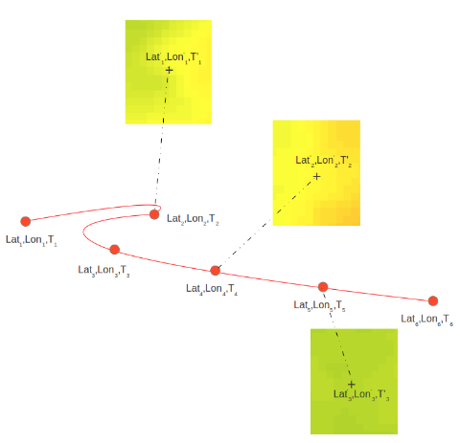
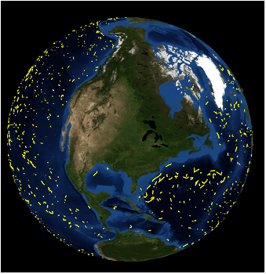
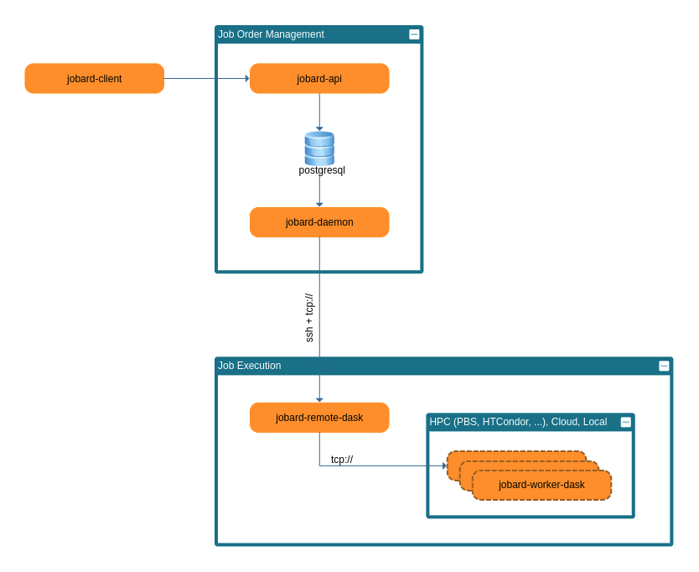
MMDB/felyx2 framework: Overview
Evolutions within Sci4MaST project (Ifremer)
Improved reliability, stability, configuration, containerization, deployment, …
Distributed processing framework (jobard: dask based) implemented for:
Docker cluster (SWARM)
HPC: HTCondor, PBS
k8s
Integrated reporting and monitoring (ES + grafana)
Gitlab CI/CD + Ansible for integration and deployment
Downloader (eo-dataflow) + reporting
Generic and configurable data collection and protocol
EUM DataStore, PO.DAAC drive, CMEMS Data Store
Opensearch, http(s), (s)ftp(s), localpath, …
Format:
MMDB: Similar to existing MMDB (Core NC + AUX NC)
In situ: Parquet

Slide 11
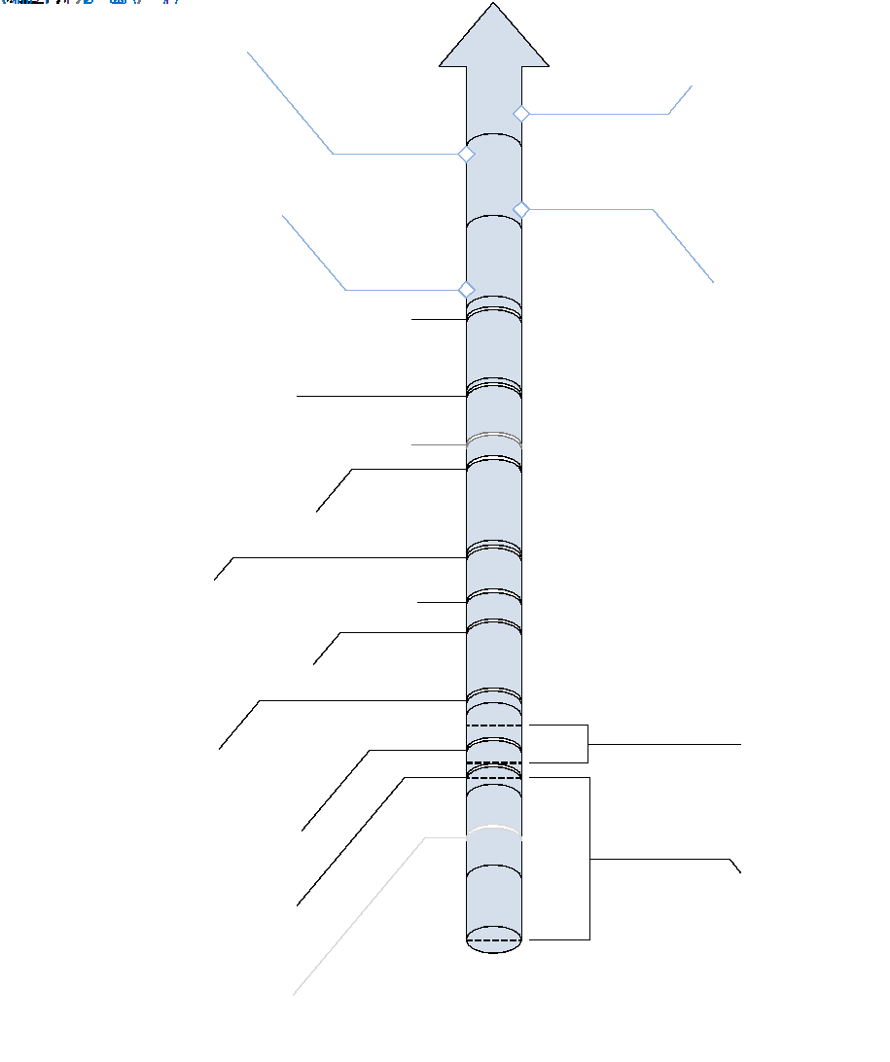
MMDB/felyx2 framework: Next
IST VAL MMDB (following IST L2 VAL repro) – Q2 2025
Upgrade SLSTR MMDB – Q4 2025/Q1 2026 (TBC)
Jointly with SLSTR Coll4 Day2 SST/Day1 IST deployment
Will run in parallel (in WEkEO) and distributed to users for preparation (at least 2-3 months before operational deployment)
Offline, internal and upcoming SST/IST MMDBs (2025/2026)
IASI-C SST, AVHRR-C SST, VIIRS N20 SST
Preparation for: SLSTR-C, CIMR SST, IASI-NG SST
SLSTR IST/SST VAL or/and OPE (TBC) repro MMDB (2026 TBC)
Using SLSTR IST/SST VAL product (including additional intermediate fields)
Work in progress to include SLSTR L0 inside MMDB
Opportunity for complete radiometer reprocessing

Slide 12
Summary
EUM SST/IST MMDB
SLSTR MMDB in current format until Day2 SST/Day1 IST deployment (Q1 2026 – TBC)
Small changes in the format (variable names/dimensions), but it will still require adaptations
New SLSTR IST/SST+MMDB reprocessing in 2026 (TBC) – (follows SL1 repro)
Opportunity to reprocess full radiometer archive
Suggested changes in ISFRN ftp directory structure
Create and maintain YYYY/MM directory structure with all radiometers and latest processor versions

Slide 13
Acknowledgments:
Noveltis, Ifremer, Jean-Francois Piolle, Radiometer teams
Thank you!
Questions are welcome

