Slide 1
New evidence of the importance of sea surface temperature measurements for constraining global carbon budgets (need for in situ skin measurements increases, and how the carbon community needs your help)
Jamie Shutler, Dan Ford
Notes:
new evidence of the importance of sea surface temperature measurements for constraining global carbon budgets
The ocean is one of two observational constraints on the global carbon assessments used to guide policy on the emission reductions that are urgently needed to stabilise our climate. Within these observation-based ocean sink estimates, sea surface temperature is a strong controller of ocean carbon concentrations and its exchange with the atmosphere. The evidence for its importance, the need for continued efforts with sea-surface temperature climate data records and particularly the need for in situ skin measurements continues to grow. This talk will discuss how the impact of seemingly small differences in sea surface temperature measurements, that can lead to large differences in the resulting ocean carbon budgets, have now been observed in situ across the Atlantic. It will also discuss the increasing need for ocean carbon specific sea-surface temperature climate data records, and why these could be critical for future global carbon assessments and the policy advice that stems from them.

Slide 2
Eunice Foote
1856
Discovered the properties of green house gases
Notes:
Eunice Foote
Womens’ rights activist, inventor and scientist.
warming effect of sunlight on different gases, and went on to theorize that changing the proportion of carbon dioxide in the atmosphere would change its temperature, in her paper Circumstances affecting the heat of the sun's rays in 1856.
Some 3+ years later in 1861 John Tyndall was experimentally demonstrating the properties of greenhouse gases.

Slide 3
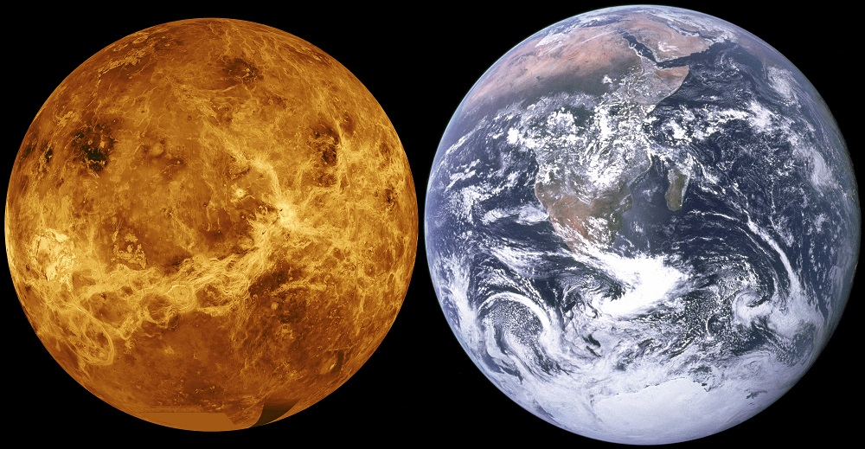
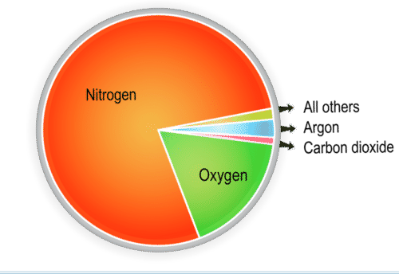
The importance of the oceans
Notes:
The Earth and Venus contain about the same amount of Carbon. But Venus has a runaway climate and the average temperature is a roasting 462oC (864oF). The reason why the Earth doesn’t have the same climate is due to large pools of carbon being locked away in sediments and the ocean. Each year about a third of anthropogenic carbon dioxide emissions are absorbed by each of the atmosphere, land and ocean biospheres. However, the oceans are unique in being able to lock this carbon away for very long periods. Consequently the global oceans are second largest carbon pool on the planet (1st is the Earth’s crust).

Slide 4
Importance of the ocean
Global carbon budgets
The oceans and atmosphere provide the two main observational constraints on global carbon budgets use to guide policy.
Advising governments to guide and motivate action.
Food security and conservation
Identify regions and ecosystems at risk.

Slide 5
Global Carbon Budget – advising global policy
How uptake is partitioned between the atmosphere, land, and ocean
sources
Fossil fuel
good estimates
Land use change
poor estimates
Uptake by vegetation
modelled
sinks
Atmosphere
measured
Ocean
Good observations and modelled
Ocean data and observations are a key constraint on global carbon budgets
Notes:
Emissions are shown above the line: Sinks are below the line. Total sources (uppermost line) exactly equal total sinks (lowermost line).
The amount by which the CO2 goes up in the atmosphere each year varies substantially

Slide 6
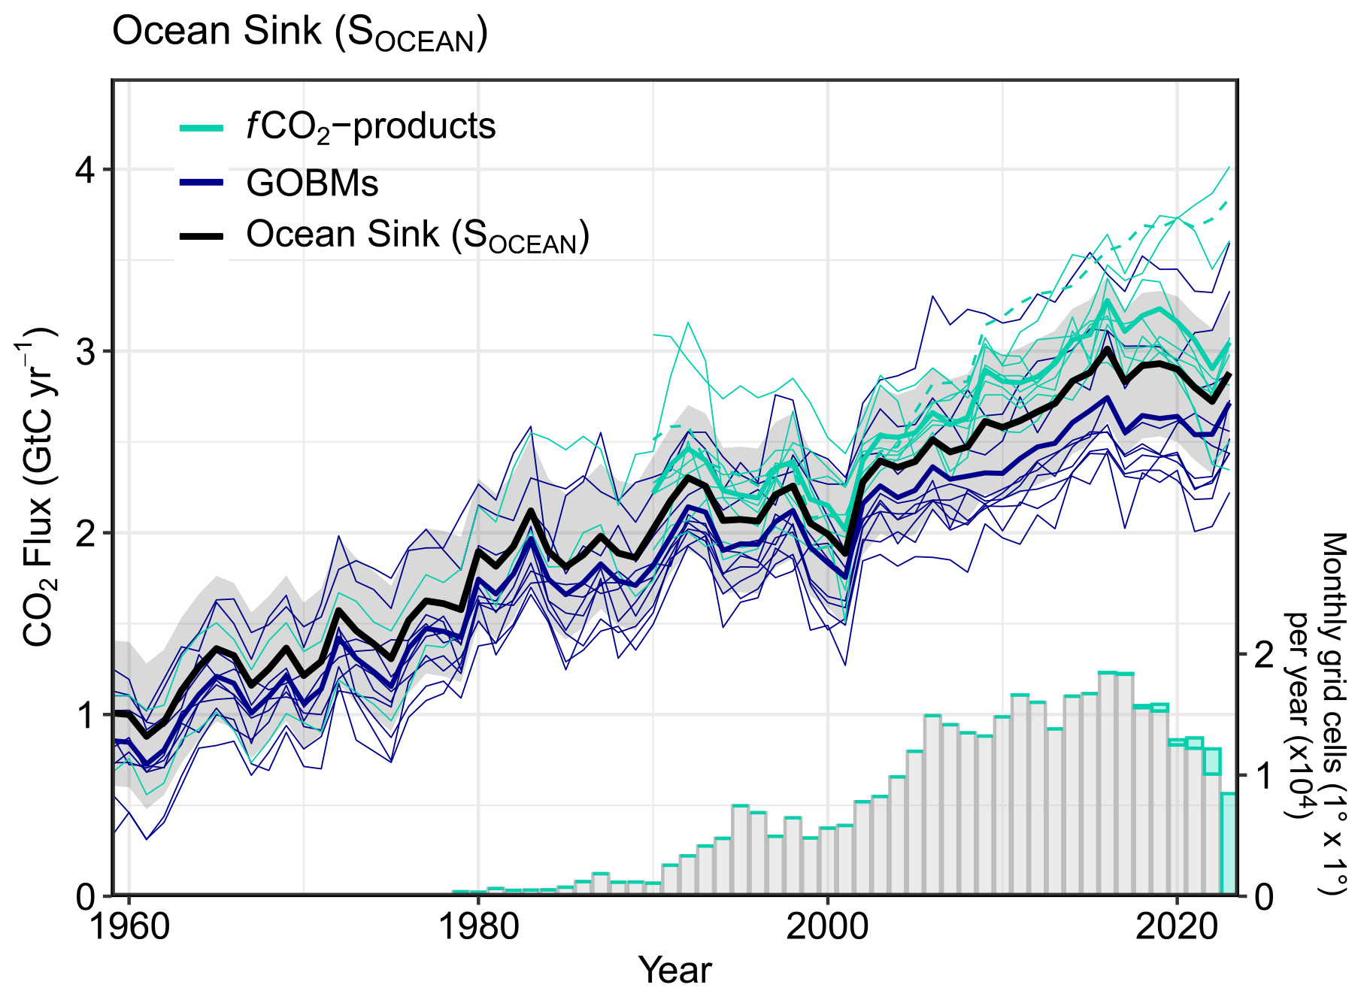
Current ocean carbon sink estimates…
Changing divergence between the observation-based and model ensembles?
(Friedlingstein et al. 2025)
Observation-based ensemble
Model ensemble
Growing realisation, the uncertainties for the observation-based products maybe underestimated…
Notes:
So how does this exchange between the ocean and atmosphere actually occur, and over what sorts of scales?

Slide 7
Current ocean carbon sink estimates…
Changing divergence between the observation-based and model ensembles?
(Friedlingstein et al. 2025)
Observation-based ensemble
Model ensemble
Yes, now revised to ~+/-0.7 Pg C yr⁻¹ (1 s.d.) (comprehensive analysis identified a ~17% increase and its time and space varying)
Growing realisation, the uncertainties for the observation-based products maybe underestimated…
Notes:
So how does this exchange between the ocean and atmosphere actually occur, and over what sorts of scales?

Slide 8
Current ocean carbon sink estimates…
Changing divergence between the observation-based and model ensembles?
(Friedlingstein et al. 2025)
Yes, but the divergence has reduced.. but is the ‘improvement’ real?
Observation-based ensemble
Model ensemble
Growing realisation, the uncertainties for the observation-based products maybe underestimated…
Notes:
So how does this exchange between the ocean and atmosphere actually occur, and over what sorts of scales?

Slide 9
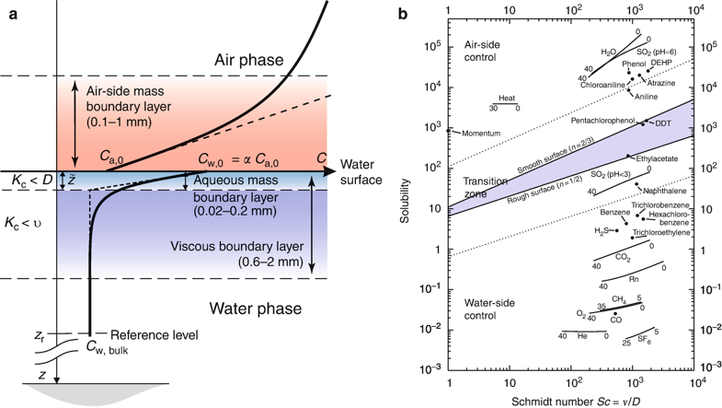
Exchange across the air-sea interface
Source: Transfer across the air-sea surface, (2013), Springer.
Notes:
Ca is the concentration in the bulk air
Cw is the concentration in the bulk water
The net flux of gas is given by the concentration difference across the film and the a kinetic, or rate term known as the gas transfer velocity.
Gas transfer is gas specific and can be controlled by both air-side and water-side processes, but often it will be dominated by one.

Slide 10
Exchange across the air-sea interface
Air
interface
water
Source: Transfer across the air-sea surface, (2013), Springer.
Notes:
Ca is the concentration in the bulk air
Cw is the concentration in the bulk water
Schmidt number is dimensionless ratio used to decribe fluid flows, ratio of momentum and mass diffusivity (v= viscous diffusion, D = mass diffusion).
The net flux of gas is given by the concentration difference across the film and the a kinetic, or rate term known as the gas transfer velocity.
Gas transfer is gas specific and can be controlled by both air-side and water-side processes, but often it will be dominated by one.

Slide 11
Competing near-surface temperature controls
Ford et al., (2024), Nature Geoscience
Garbe, C.S. et al. (2014). Transfer Across the Air-Sea Interface. In: Liss, P.S., Johnson, M.T. (eds) Ocean-Atmosphere Interactions of Gases and Particles. Springer Earth System Sciences. Springer, Berlin, Heidelberg. https://doi.org/10.1007/978-3-642-25643-1_2
Notes:
So near-surface termperature gradients are critical – what sorts of impacts can these have on global estimates?
Can we investigate them in situ?

Slide 12
The evidence continues to grow supporting the impacts of near surface temperature gradients…
Well established and accepted within SST community (i.e GHRSST)
Donlon, C. J. et al. Toward improved validation of satellite sea surface skin temperature measurements for climate research. J. Clim. 15, 353–369 (2002).
International agreement on the existence of these gradients and have terminology to define the depth of observation (i.e GHRSST)
From the theory
Woolf, D. K., Land, P. E., Shutler, J. D., et al. On the calculation of air-sea fluxes of CO2 in the presence of temperature and salinity gradients. J. Geophys. Res.: Oceans 121, 1229–1248 (2016).
Mcgillis, W. R. & Wanninkhof, R. Aqueous CO2 gradients for air–sea flux estimates. Mar. Chem. 98, 100–108 (2006).
Theoretical work laid down the foundation of the impact of these near surface gradients on air-sea CO₂ fluxes
From the laboratory
Falkenroth, A., Degreif, K. & Jähne, B. in Transport at the Air–Sea Interface 59–72 (Springer Berlin Heidelberg, 2007); https://doi.org/10.1007/978-3-540-36906-6_4
The concentration gradients were imaged in the laboratory for poorly soluble oxygen (CO₂ also poorly soluble)
From the observation-based analyses
Woolf, D. K. et al. Key uncertainties in the recent air–sea flux of CO2. Glob. Biogeochem. Cycles 33, 1548–1563 (2019).
Shutler, J. D. et al. Satellites will address critical science priorities for quantifying ocean carbon. Front. Ecol. Environ. 18, 27–35 (2020).
Watson, A. J. et al. Revised estimates of ocean-atmosphere CO2 flux are consistent with ocean carbon inventory. Nat. Commun. 11, 4422 (2020).
Dong, Y. et al. Update on the temperature corrections of global air–sea CO2 flux estimates. Glob. Biogeochem. Cycles 36, e2022GB007360 (2022).
Observation-based analyses and the models scaled these impacts to the global scale
(~0.18 – 0.6 Pg C yr⁻¹)
From the models
Bellenger, H. et al. Sensitivity of the global ocean carbon sink to the ocean skin in a climate model. JGR Oceans 128, e2022JC019479 (2023).
But the in situ evidence has been lacking…

Slide 13
In situ evidence supporting near surface temperature gradients
Recent work in Nature Geoscience (Ford et al. 2024) and Science Advances (Dong et
al. 2024) provide in situ evidence supporting near surface temperature gradients
Ford, D.J., Shutler, J.D., Blanco-Sacristán, J. et al. Enhanced ocean CO2 uptake due to near-surface temperature gradients. Nat. Geosci. 17, 1135–1140 (2024). https://doi.org/10.1038/s41561-024-01570-7

Slide 14
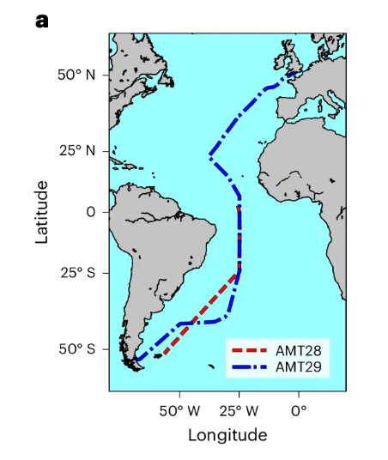
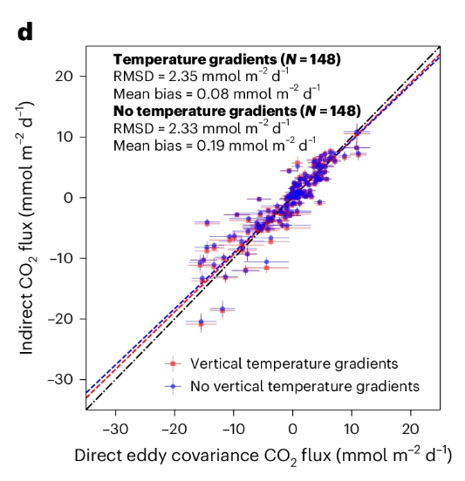
In situ evidence supporting near surface temperature gradients
Recent work in Nature Geoscience (Ford et al. 2024) and Science Advances (Dong et al. 2024) provide in situ evidence supporting near surface temperature gradients
Natural vertical temperature gradients supports an increase of
0.18 Pg C yr⁻¹ in the global ocean CO₂ sink
Ford, D.J., Shutler, J.D., Blanco-Sacristán, J. et al. Enhanced ocean CO2 uptake due to near-surface temperature gradients. Nat. Geosci. 17, 1135–1140 (2024). https://doi.org/10.1038/s41561-024-01570-7

Slide 15
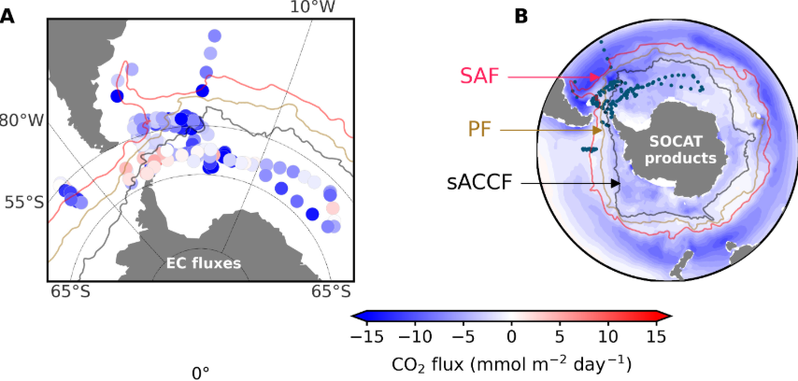
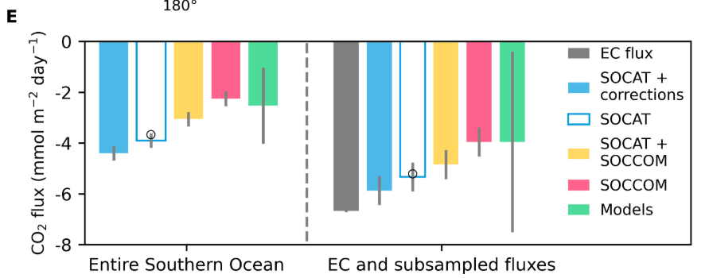
In situ evidence supporting near surface temperature gradients
Recent work in Nature Geoscience (Ford et al. 2024) and Science Advances (Dong et
al. 2024) provide in situ evidence supporting near surface temperature gradients
In situ eddy covariance observations in the Southern Ocean were compared to a suite of fCO₂ observation–based and biogeochemical model CO₂ fluxes
Subsampling the CO₂ fluxes to the eddy covariance observations, better agreement was found with the observation-based CO₂ fluxes with temperature corrections applied
Dong, Y., Bakker, D. C. E., Bell, T. G., Yang, M., Landschützer, P., Hauck, J., et al. (2024). Direct observational evidence of strong CO2 uptake in the Southern Ocean. Science Advances, 10(30), eadn5781. https://doi.org/10.1126/sciadv.adn5781

Slide 16
What about the near surface salinity gradients and rain effects?
From the theory (“salty” skin)
Woolf, D. K., Land, P. E., Shutler, J. D., et al. On the calculation of air-sea fluxes of CO2 in the presence of temperature and salinity gradients. J. Geophys. Res.: Oceans 121, 1229–1248 (2016).
Theoretical work indicated the impact of the “salty” skin on air-sea CO₂ fluxes
From the models (“salty” skin)
Bellenger, H. et al. Sensitivity of the global ocean carbon sink to the ocean skin in a climate model. JGR Oceans 128, e2022JC019479 (2023).
Theory scaled globally using ocean models and observation-based approaches indicate a reduced CO₂ sink of ~0.05 Pg C yr⁻¹
From the observation-based analysis (rain)
Ashton, I. G., Shutler, J. D., Land, P. E., Woolf, D. K. & Quartly, G. D. A sensitivity analysis of the impact of rain on regional and global sea–air fluxes of CO2. PLoS ONE 11, e0161105 (2016).
Rain shown to impact the near surface salinity gradients, and directly exchange CO₂ into the oceans
From the models (rain)
Parc, L., Bellenger, H., Bopp, L. et al. Global ocean carbon uptake enhanced by rainfall. Nat. Geosci. 17, 851–857 (2024). https://doi.org/10.1038/s41561-024-01517-y
These rain effects have been shown to increase the ocean CO₂ sink by
0.14 to 0.19 Pg C yr⁻¹
The impacts of near surface layers (temperature and salinity) are not static through time and are regionally varying

Slide 17
Returning to the “artificial” temperature gradients…
The artificial gradients includes many components:
Not all ships measure at the same depth
Warming of seawater in the ship before measurement is taken
Mis-calibrated temperature sensors
Results in a bias within the SOCAT observations
Artificial warm bias in SOCAT well known, but the magnitude depends on the method used to assess it
0.09 K - Goddijn-Murphy et al. (2015) satellite | 0.02K – Dong et al. (2022) drifters
Correcting the fCO_{2 (sw)} observations to a consistent temperature dataset at a depth representative for air-sea CO₂ exchange can correct these artificial gradients

Slide 18
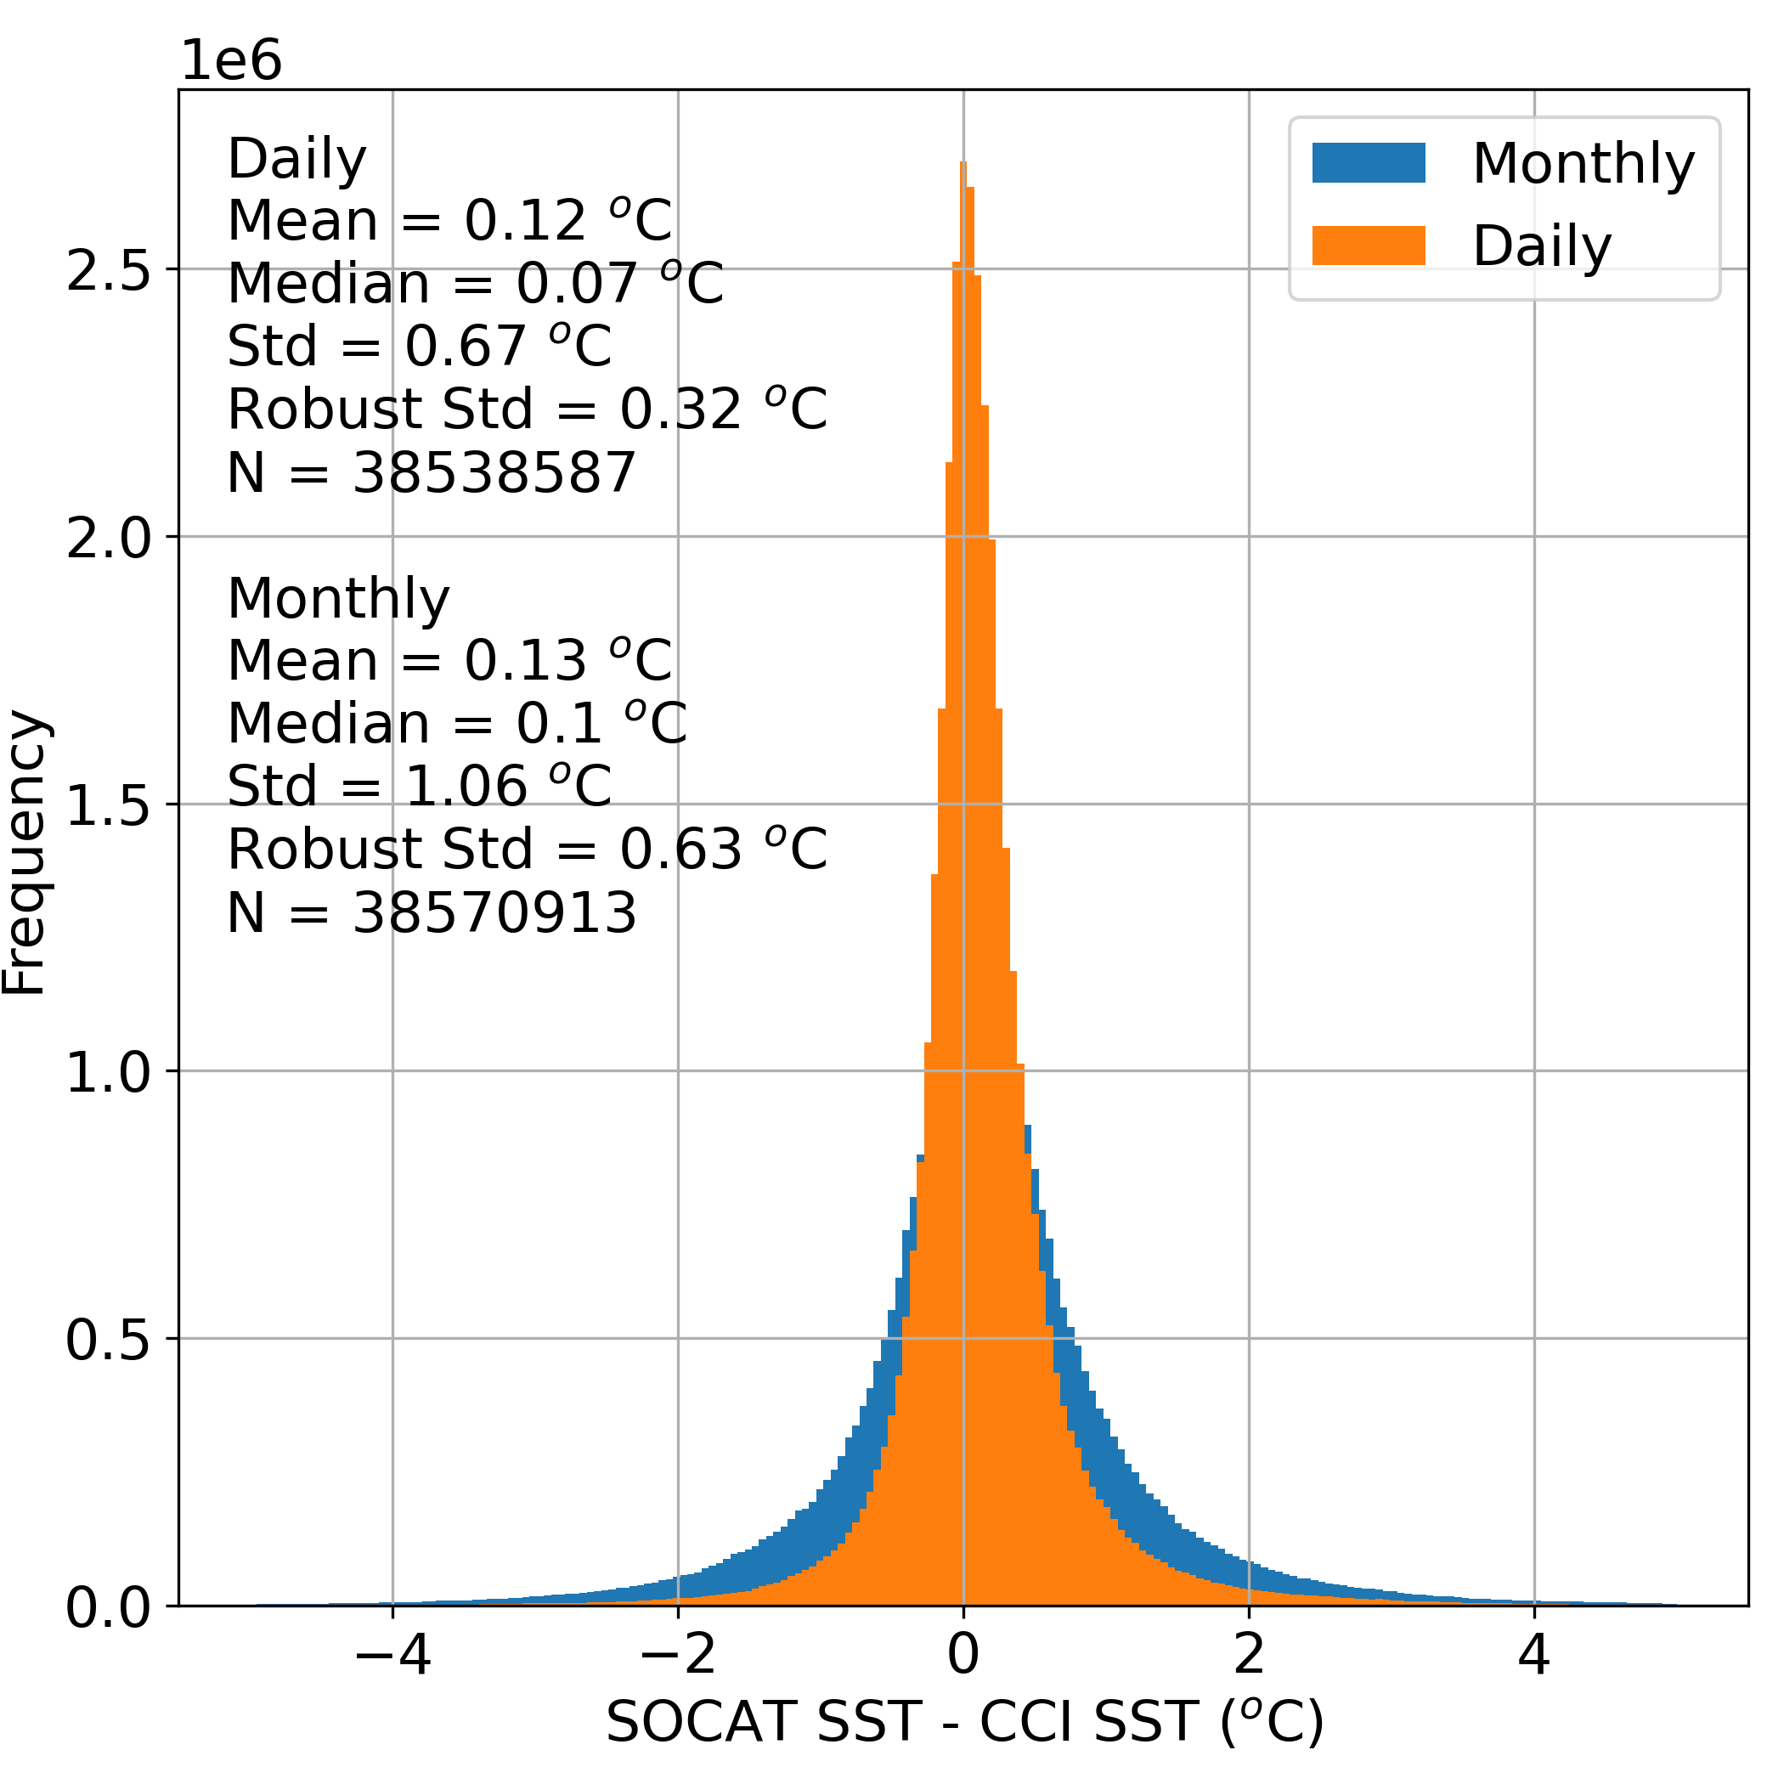
Returning to the “artificial” temperature gradients…
Matching the SOCAT observations to a satellite temperature climate data record
Initial analysis conducted on European Space Agency Climate Change Initiative SST record
(with a ~0.04K cool bias removed with respect to surface SST drifters)
Monthly 1 degree
These data are routinely produced, and published using monthly 1 degree temperature
(Ford et al. 2024; Ford et al. 2023; etc…)
Daily ~4km
A warm bias in SOCAT appears present on order of ~0.1 ºC
Recent work has begun evaluating matching these to daily full resolution temperature records
Daniel J. Ford, Jamie D. Shutler, et al. (2024). Reanalysed (depth and temperature consistent) surface ocean CO₂ atlas (SOCAT) version 2024 (v1.1) (v1.1) [Data set]. Zenodo. https://doi.org/10.5281/zenodo.13284017
Ford, D. J., Sims, R. P., Shutler, J. D., et al. (2023). Reanalysed (depth and temperature consistent) surface ocean CO₂ atlas (SOCAT) version 2023 (Version 2023-0) [Data set]. Zenodo. https://doi.org/10.5281/ZENODO.8229316

Slide 19
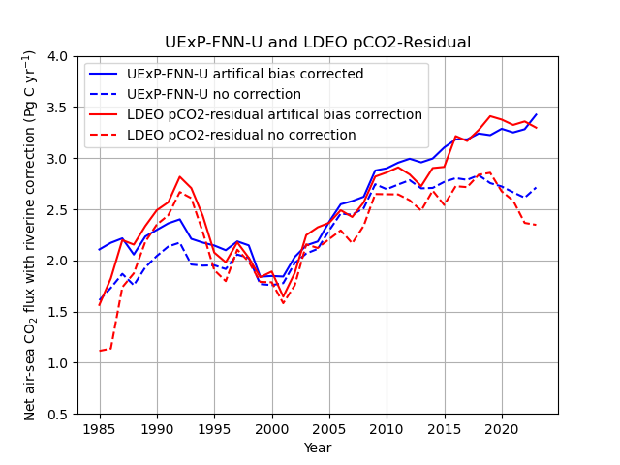
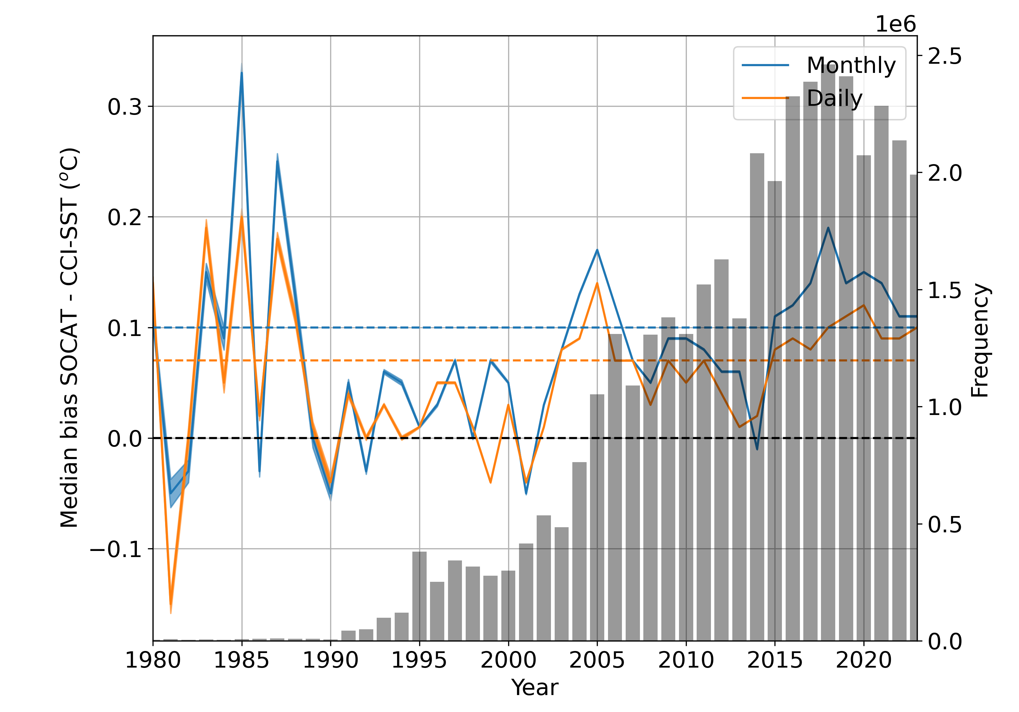
Returning to the “artificial” temperature gradients…
The warm bias appears to be increasing since 2000
Preliminary
Warm layers + artificial components
Impact of artificial gradient using daily matched reanalysed observations
Ford, D.J., Shutler, J.D., et al. Reanalysed SOCAT observations for global ocean CO2 sink assessments (in prep)

Slide 20
Current ocean carbon sink estimates…
Changing divergence between the observation-based and model ensembles?
(Friedlingstein et al. 2025)
So divergence has actually increased (observation-based methods show a annual increase since year 2000, models have flatlined since 2000)
Observation-based ensemble
Model ensemble
Growing realisation, the uncertainties for the observation-based products maybe underestimated…
likely correct line (red dotted)
Notes:
So how does this exchange between the ocean and atmosphere actually occur, and over what sorts of scales?

Slide 21
Outcomes and conclusions
Global carbon budget (GCB) teams agree we need to consider temperature issues.
overwhelming evidence base has highlighted this need.

Slide 22
Outcomes and conclusions
Global carbon budget (GCB) teams agree we need to consider temperature issues.
overwhelming evidence base has highlighted this need.
Agreed for the 2025 GCB assessment: all 8 observation-based data products will include results using reanalysed dissolved CO₂ data (and non-reanalysed ie biased warm as a comparison).

Slide 23
Outcomes and conclusions
Global carbon budget (GCB) teams agree we need to consider temperature issues.
overwhelming evidence base has highlighted this need.
Agreed for the 2025 GCB assessment: all 8 observation-based data products will include results using reanalysed dissolved CO₂ data (and non-reanalysed ie biased warm as a comparison).
GCB 2025 assessment will require/exploit ESA SST CCI CDR dataset (i.e., now being used by all 8 international teams). not using OISST due to drift (covered last year).

Slide 24
Outcomes and conclusions
Global carbon budget (GCB) teams agree we need to consider temperature issues.
overwhelming evidence base has highlighted this need.
Agreed for the 2025 GCB assessment: all 8 observation-based data products will include results using reanalysed dissolved CO₂ data (and non-reanalysed ie biased warm as a comparison).
GCB 2025 assessment will require/exploit ESA SST CCI CDR dataset (i.e., now being used by all 8 international teams). not using OISST due to drift (covered last year).
We have further (independent) evidence that the observation-based data products are correct (ie models are underestimating ocean sink)
something for next years workshop!

Slide 25
Outcomes and conclusions
Global carbon budget (GCB) teams agree we need to consider temperature issues.
overwhelming evidence base has highlighted this need.
Agreed for the 2025 GCB assessment: all 8 observation-based data products will include results using reanalysed dissolved CO₂ data (and non-reanalysed ie biased warm as a comparison).
GCB 2025 assessment will require/exploit ESA SST CCI CDR dataset (i.e., now being used by all 8 international teams). not using OISST due to drift (covered last year).
We have further (independent) evidence that the observation-based data products are correct (ie models are underestimating ocean sink)
something for next years workshop!
ESA Ocean Carbon for Climate (OC4C) is (hopefully) funding some SSTskin work.

Slide 26
Outcomes and conclusions
Global carbon budget (GCB) teams agree we need to consider temperature issues.
overwhelming evidence base has highlighted this need.
Agreed for the 2025 GCB assessment: all 8 observation-based data products will include results using reanalysed dissolved CO₂ data (and non-reanalysed ie biased warm as a comparison).
GCB 2025 assessment will require/exploit ESA SST CCI CDR dataset (i.e., now being used by all 8 international teams). not using OISST due to drift (covered last year).
We have further (independent) evidence that the observation-based data products are correct (ie models are underestimating ocean sink)
something for next years workshop!
ESA Ocean Carbon for Climate (OC4C) is (hopefully) funding some SSTskin work.
There is a desire (need?) for an “air-sea gas exchange SST CDR” e.g., top and bottom of mass boundary layer (MBL) SST.
Currently using 0.2 m SST as bottom of MBL and NOAA COARE model (and ERA-5 data + SST at 0.2 m) to determine the skin SST which is used as best estimate of the top of MBL.

Slide 28
Returning to the “artificial” temperature gradients…
Can we use these satellite climate data records to aid in the quality control of SOCAT?
Plotted cruises where the SST difference is greater than 2 times CCI-SST uncertainty (~95% confidence)
2020 - 2023
Ford, D.J., Shutler, J.D., et al. Reanalysed SOCAT observations for global ocean CO2 sink assessments (in prep)

Slide 29
Which climate record should we use?
Global bias between OISST and CCI does not appear to change during this period, but regional changes in the temperate in northern latitudes and Southern Ocean could cause the observed discrepancy.
These regional biases increase from 2015 through to 2021, which combined with high gas exchange in polar regions could explain the shift between OISST and CCI results…
~0.25 PgC
Notes:
So how can we investigate these regional issues, or what is driving them within the gas fluxes?

