Slide 1
Update on deployments of the M-AERIs (Marine-Atmospheric Emitted Radiance Interferometers)
Peter J Minnett, Miguel Angel Izaguirre,
and Goshka Szczodrak
Dept. Ocean Sciences, Rosenstiel School of Marine, Atmospheric, and Earth Science, University of Miami, Miami, USA
pminnett@rsmas.miami,edu pminnett@earth.miami.edu

Slide 2
M-AERI
The Marine-Atmospheric Emitted Radiance Interferometer (M-AERI) is an accurate, self-calibrating, Fourier transform IR spectroradiometer that measures emission spectra from the sea and atmosphere.
At sea calibration by two internal blackbody cavities with thermometers with SI-traceable calibration.
Calibration sequence before and after each cycle of measurements.
Calibration before and after deployments using NIST-designed water-bath blackbody calibration target at RSMAS. Uses SI-traceable thermometers at mK accuracy.
Periodic radiometric characterization of RSMAS water-bath blackbody calibration target by NIST TXR and NPL AMBER.
M-AERIs run autonomously.
SST_{skin} derived from spectral radiance measurements at ~7.7 µm.
Minnett, P.J., Knuteson, R.O., Best, F.A., Osborne, B.J., Hanafin, J.A., & Brown, O.B. (2001). The Marine-Atmospheric Emitted Radiance Interferometer (M-AERI), a high-accuracy, sea-going infrared spectroradiometer. Journal of Atmospheric and Oceanic Technology, 18, 994-1013

Slide 3
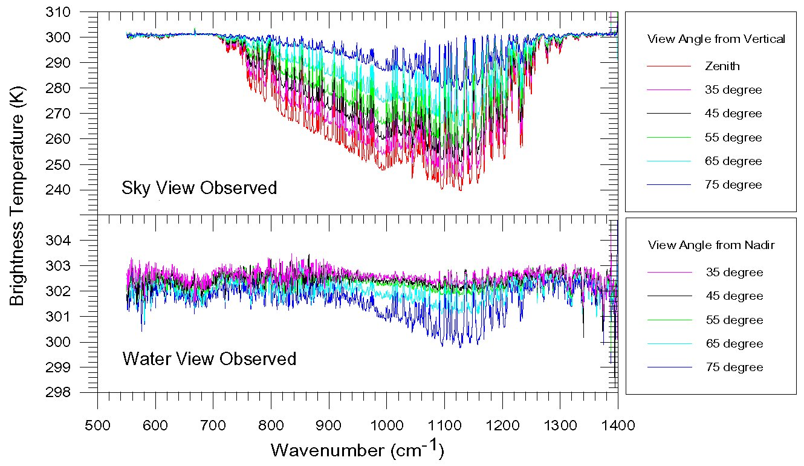
M-AERI at-sea measurements
Minnett, P.J., Knuteson, R.O., Best, F.A., Osborne, B.J., Hanafin, J.A., & Brown, O.B. (2001). The Marine-Atmospheric Emitted Radiance Interferometer (M-AERI), a high-accuracy, sea-going infrared spectroradiometer. Journal of Atmospheric and Oceanic Technology, 18, 994-1013

Slide 4
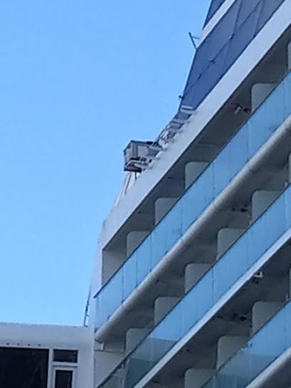
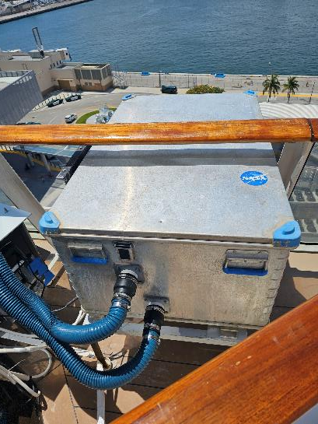
M-AERI on Celebrity Equinox

Slide 5
Consequences of COVID-19 – Royal Caribbean
Royal Caribbean ships were voluntarily idled in March 2020. We had no access to the instruments on the ships.
Cruises were resumed once vaccines were widely used, and in late 2022 we started refurbishing the mountings on the Celebrity Equinox.
Data from the Celebrity Equinox restarted on August 19, 2023.

Slide 6
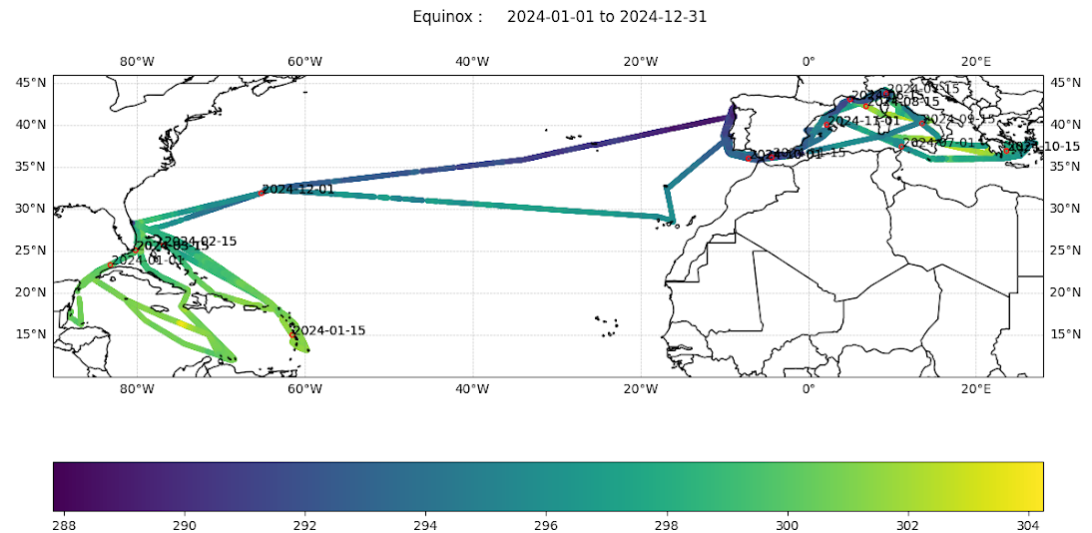
M-AERI data from Celebrity Equinox 2024

Slide 7
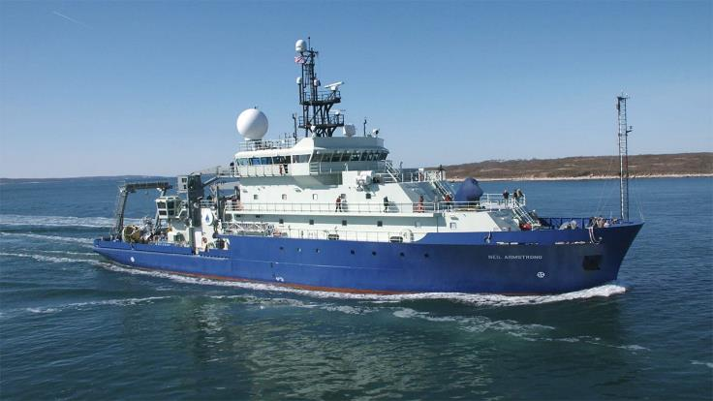
M-AERI on the R/V Neil Armstrong
Installed M-AERI on the R/V Neil Armstrong, completed on March 31, 2024.
Sails predominantly in northern Atlantic.
https://www.whoi.edu/what-we-do/explore/ships/ships-neil-armstrong/

Slide 8
M-AERI on the R/V Neil Armstrong
Our equipment was removed from the R/V Neil Armstrong in March 2025.
Now back in the lab for refurbishment and recalibration.
Data have been processed (preliminary) and are available.

Slide 9
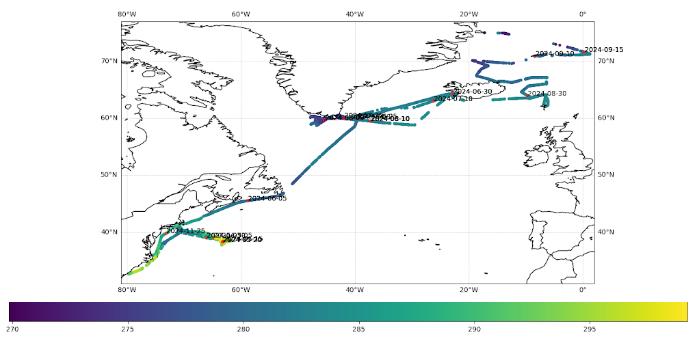
M-AERI data from R/V Neil Armstrong April – November 2024.

Slide 10
Future Plans
Deployment on Celebrity Equinox to continue: Mediterranean, S. Atlantic, Mediterranean....
Second ship being sought – NOAA S Ronald H. Brown or another RCG cruise liner.
3rd M-AERI being refurbished for at-sea deployment.
4th M-AERI will be cannibalized for parts.

Slide 11
Constraints
Currently funded by NASA for MODIS and VIIRS SST_{skin} algorithm and accuracy assessment grants.
MODISs on Terra and Aqua will decommissioned in the next couple of years. Our grant runs to September 2026.
Our VIIRS grant is in a No-Cost Extension until February 2026. Not clear what will happen after that…

Slide 12
Summary
M-AERI cruise operations have resumed following the limitations imposed by the COVID-19 pandemic, but at a reduced scope.
SST_{skin} datasets continue to be available for Ships4SST archive.

Slide 13
Acknowledgments
Funding from NASA.
Support from Royal Caribbean Group.
Support from WHOI and R/V Neil Armstrong.

Slide 14
Thank you.

