Slide 1
Using ships4sst data to validate SLSTR data
Werenfrid Wimmer
W. Wimmer, T. Nightingale, J. Høyer, R. Wilson, H. Kelliher, C. Donlon
With contributions from: A. Lee, G. Dybkjær, R. Holmes, J.F. Piolle, I. Tomazic

Slide 2
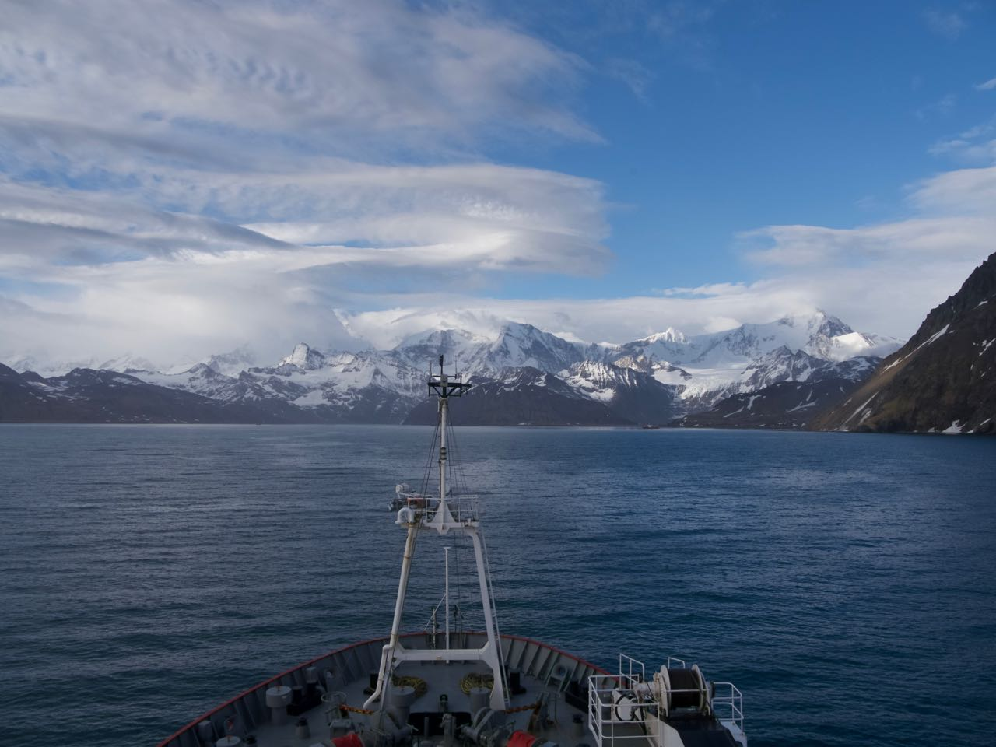
Outline
Introduction
  Data sources and processing
  Validation methods
Validation Results
  NRT 2020 - 2022 – WST
  Results per year - WST
  D3, D2, N3, N2 results for the 2020 - 2022 data
Conclusion

Slide 3
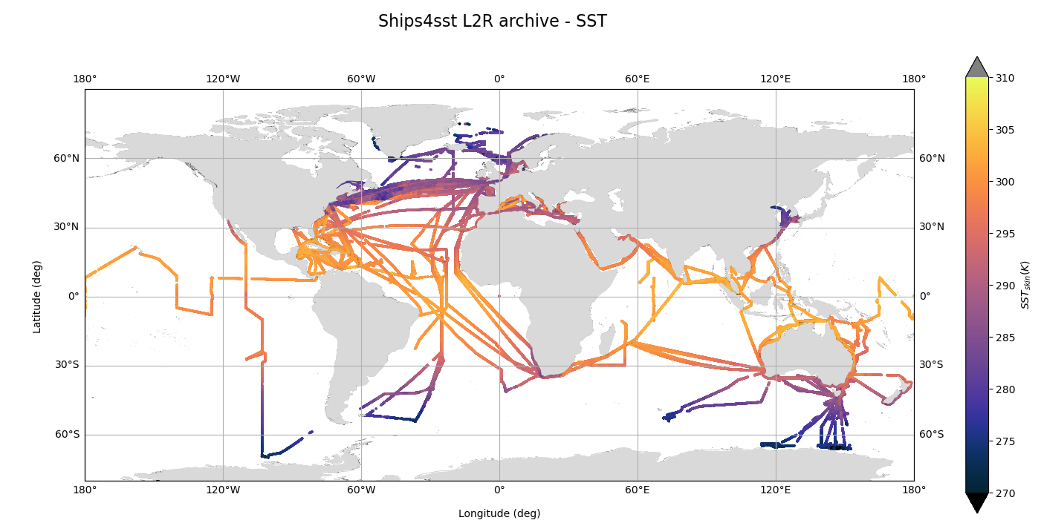
Data
SLSTR
    NRT data 2018-2024
  FRM
    Radiometer data from ships4sst
  The MDB files are produced by Felyx
  SLSTR L1b and L2 data within 400x400 pixels of match-up
  L2R data within 6hrs of match-up

Slide 4
Validation methods
MDB files (as produced by felyx) are reprocessed
  allow multiple matches per match-up location (overpass)
  Validate WST, D3, D2, N3, N2 and all GHRSST CV levels (0, 3,4,5)
      Results are only shown for GHRSST CV 5 (best quality)
  follow the Wimmer et.al. 2012 approach.
Wimmer et. al. 2012:
  Match-up grades
Wimmer, W., Robinson, I. S., & Donlon, C. J. (2012). Long-term validation of AATSR SST data products using shipborne radiometry in the Bay of Biscay and English Channel. Remote Sensing of Environment, 116, 17-31. DOI: 10.1016/j.rse.2011.03.022

Slide 5
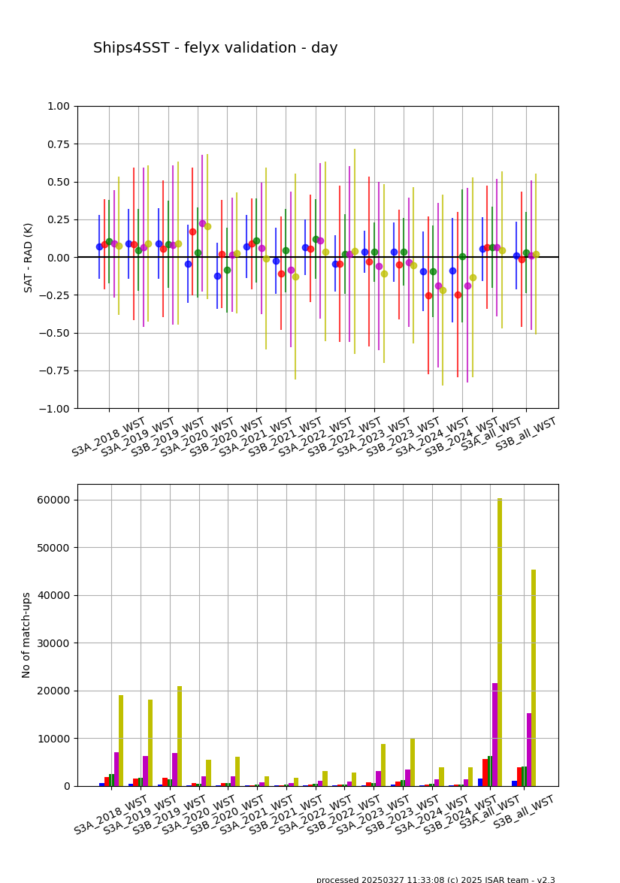
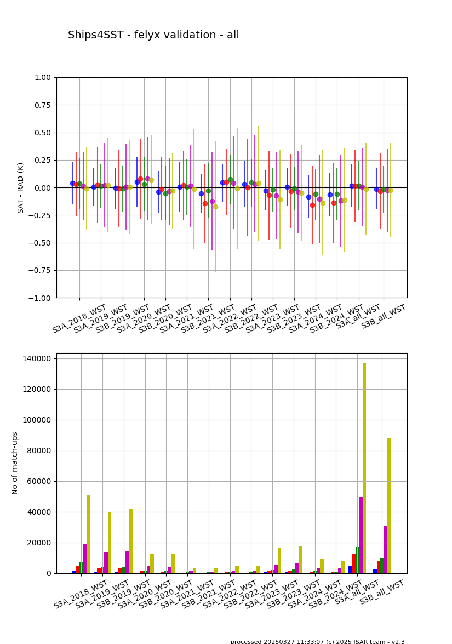
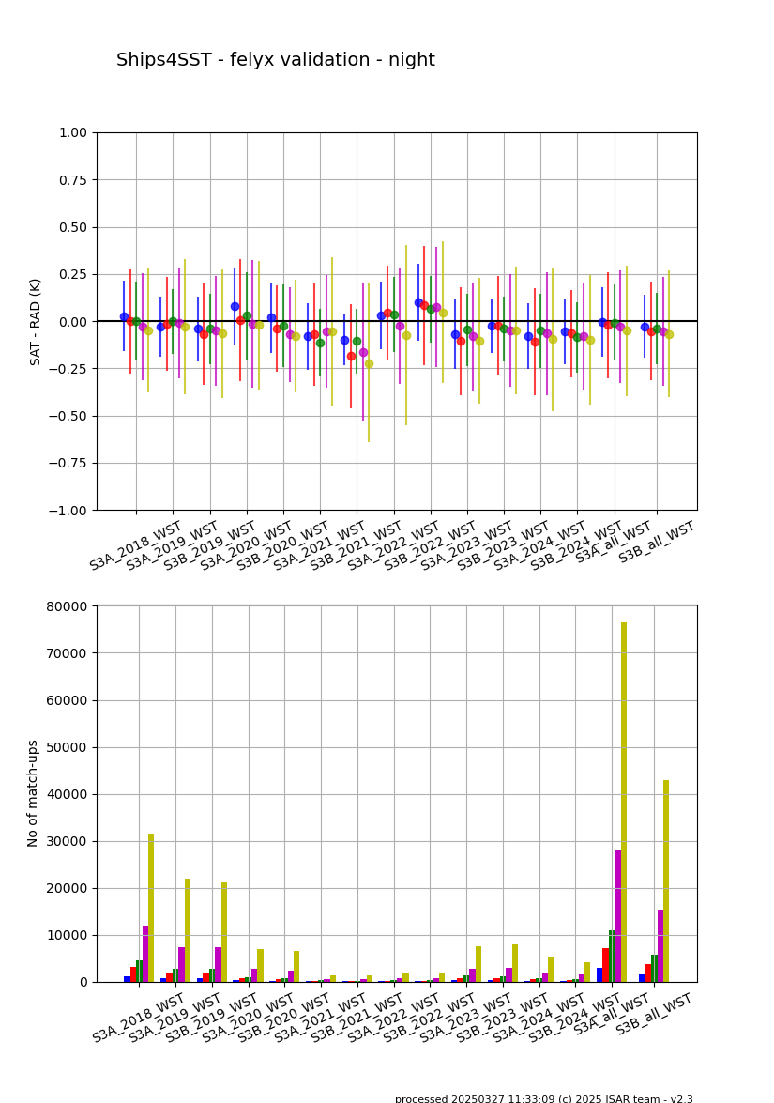
Validation results - global
Day
WST – 2018 - 2024, CV 5
All
Night

Slide 6
Validation results - global
Day
WST – 2018 - 2024, CV 5
All
Night

Slide 7
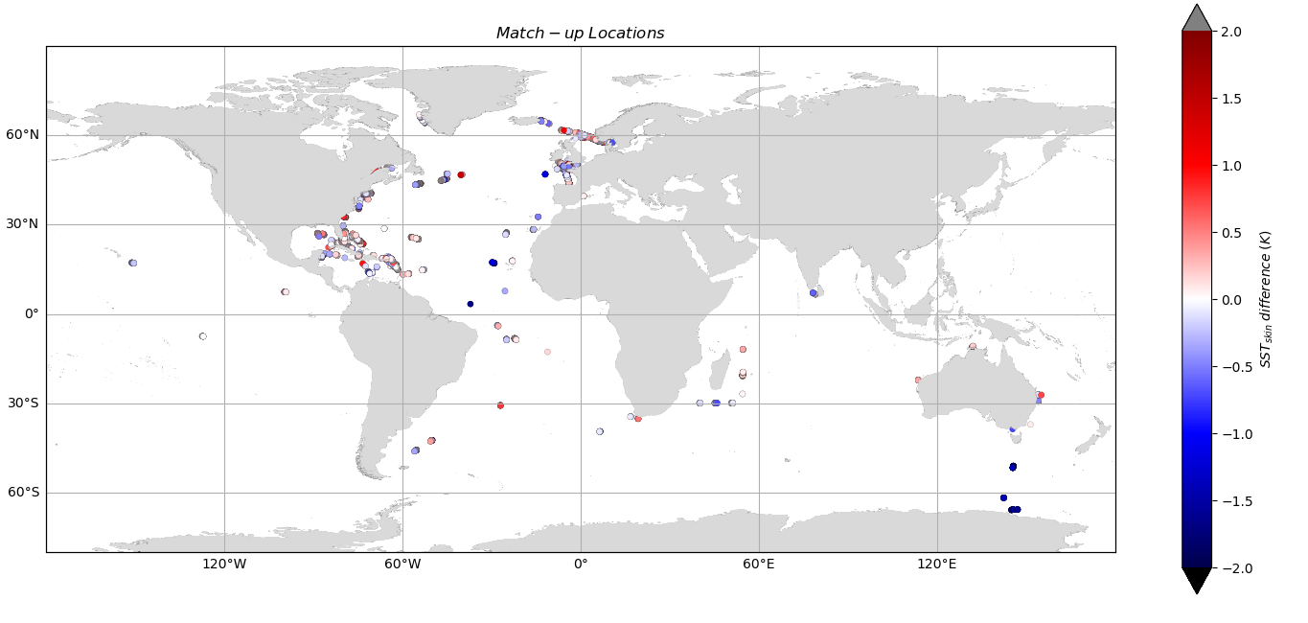
Validation results - global
WST – 2018 - 2024, CV5, grade 2b - S3A

Slide 8
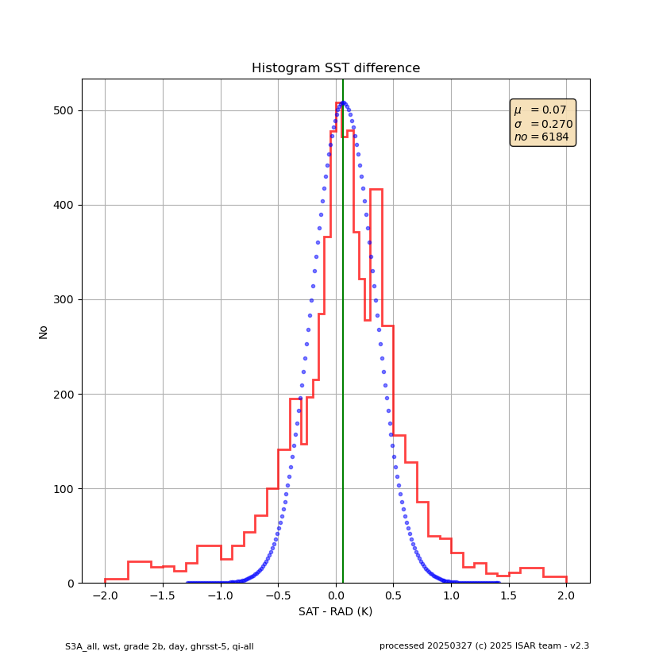
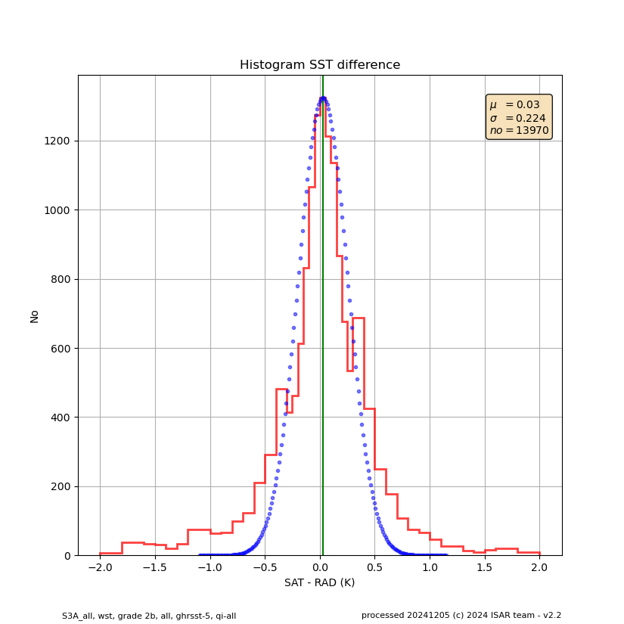
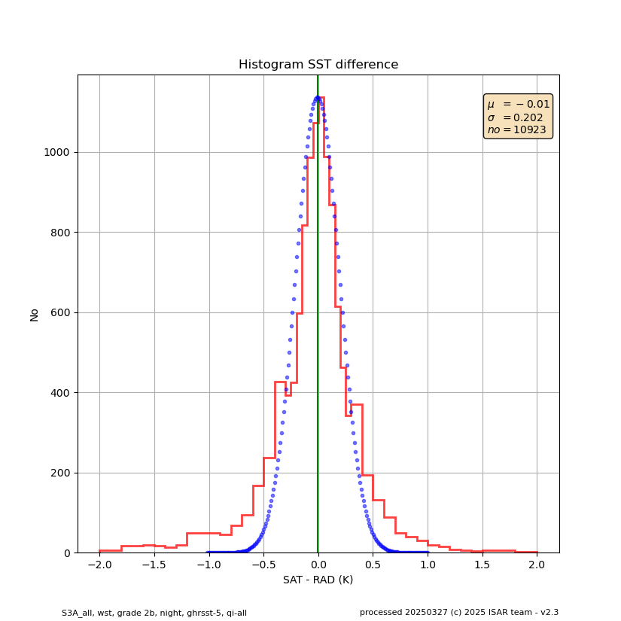
Histograms – CV5
Day
2018 -2024 – S3A
All
Night
11 May 2020
Page

Slide 9
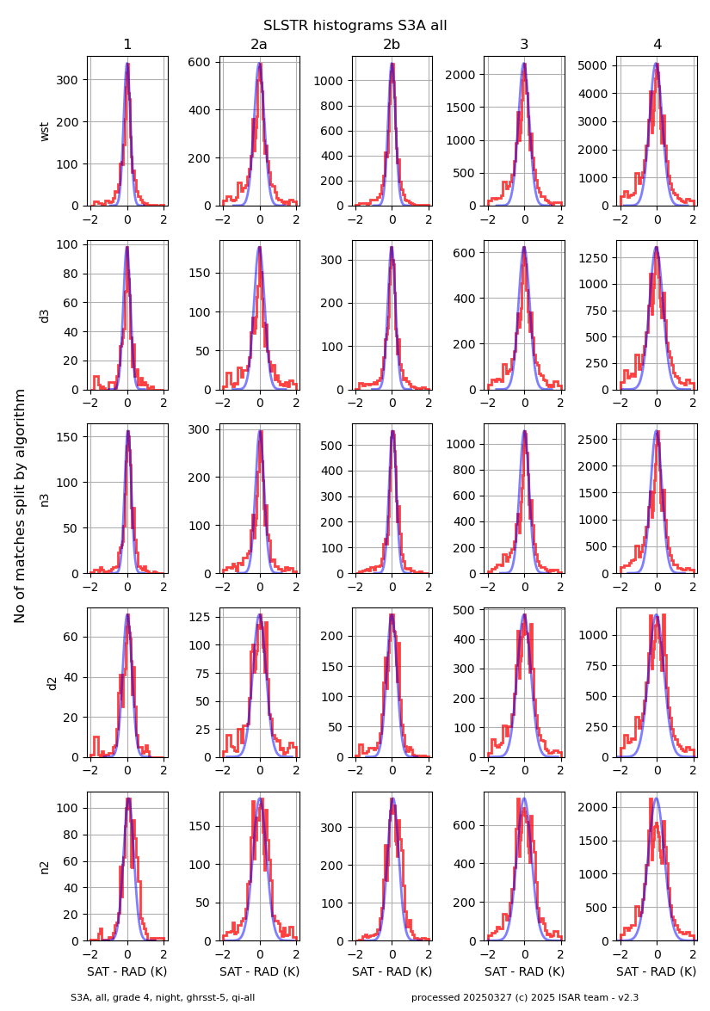
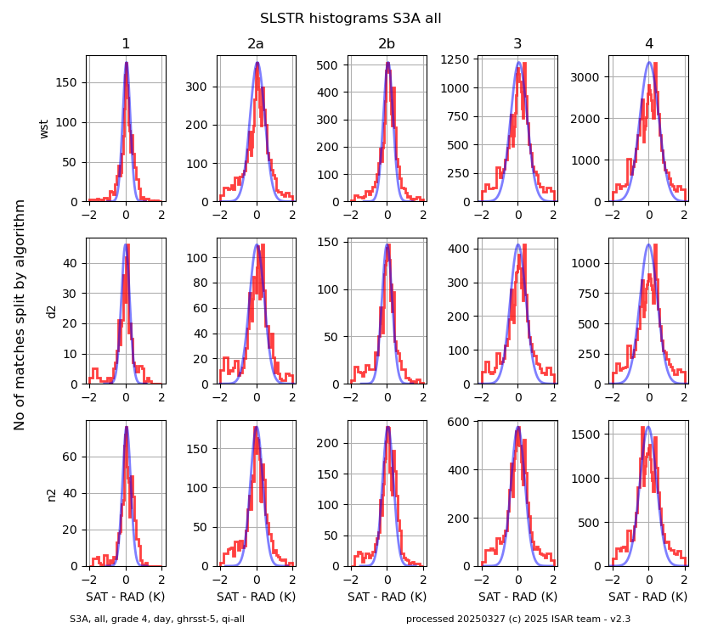
Night
Validation – histograms
2018-2024 – S3A - CV5
Day

Slide 10

Validation results - global
WST - 2018-2024, CV5, grade 2b - S3B

Slide 11
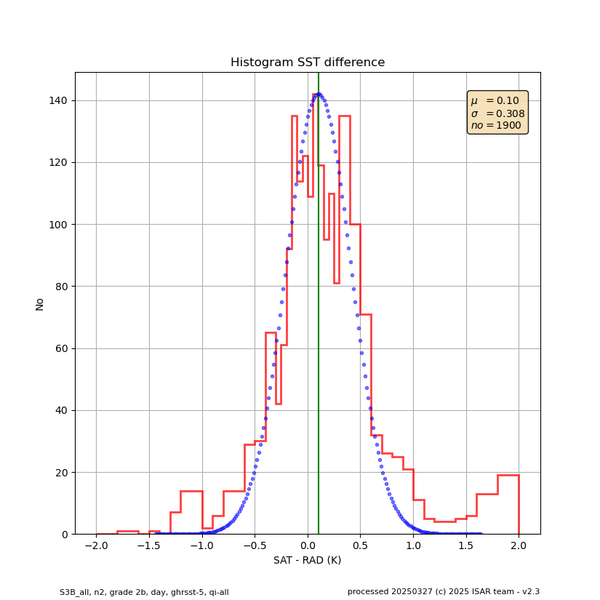
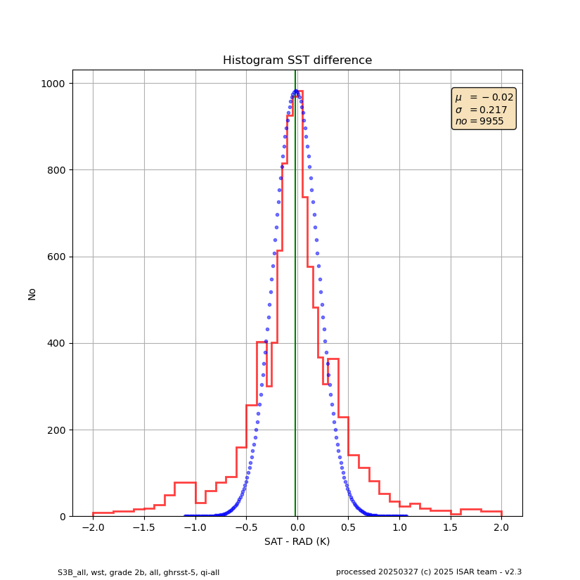
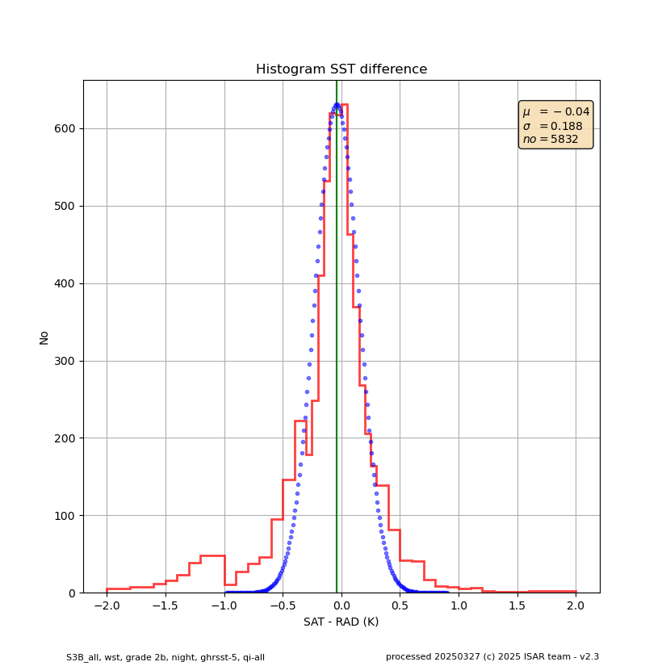
Histograms – CV5
Day
2020 - S3B
All
Night
11 May 2020
Page

Slide 12
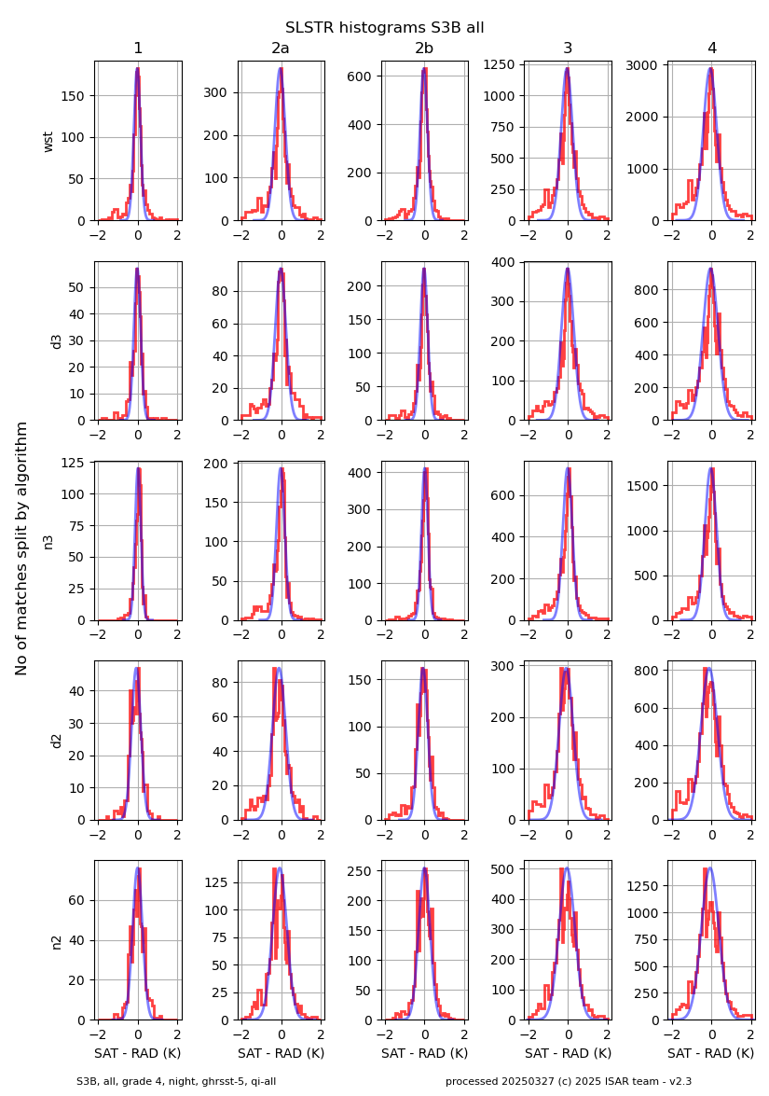
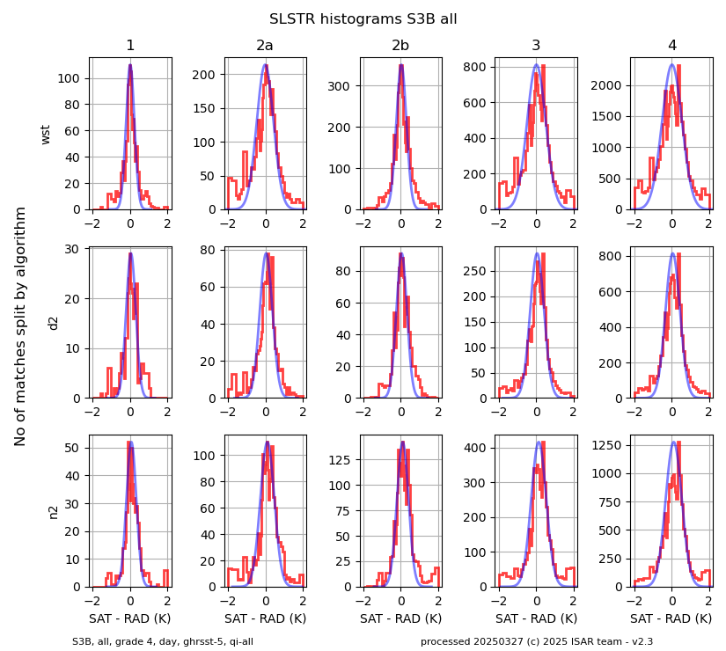
Night
Validation – histograms
2018 – 2024 – S3B - CV5
Day

Slide 13
Validation results – statistics
B
2018 2024 – S3 A vs B – WST CV5
A

Slide 14
Validation results – statistics
B
2018 2024 – S3 A vs B
  D3/N3 CV5
A

Slide 15
Validation results – statistics
B
2018 2024 – S3 A vs B
  D2/N2 CV5 day
A

Slide 16
Validation results – statistics
B
2018 2024 – S3 A vs B
  D2/N2 CV5 night
A

Slide 17
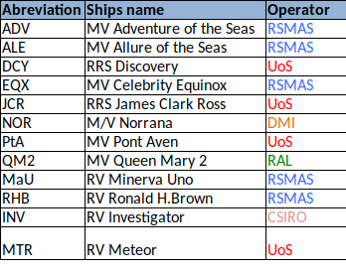
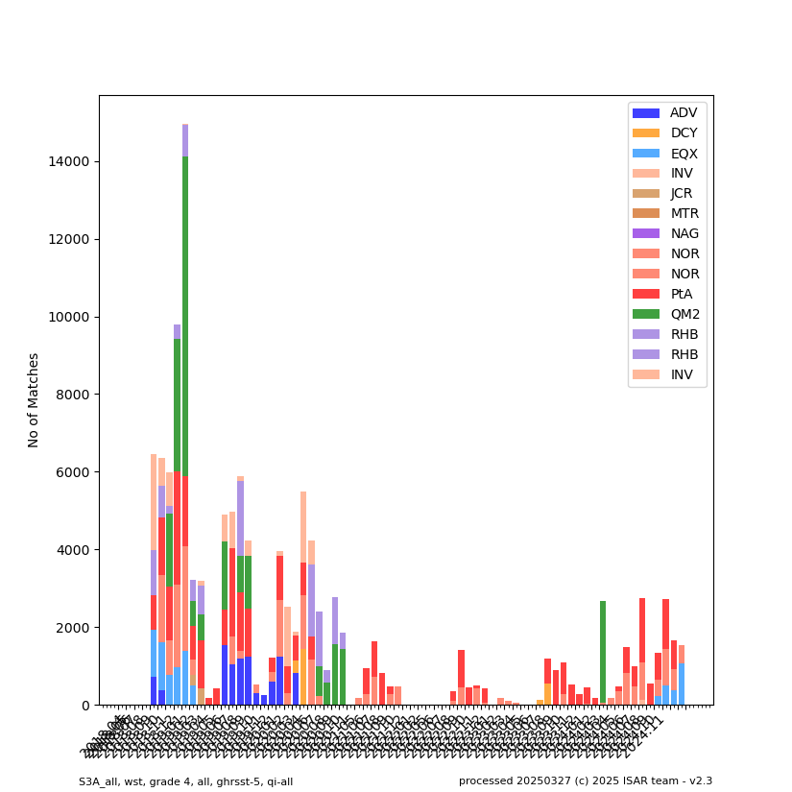
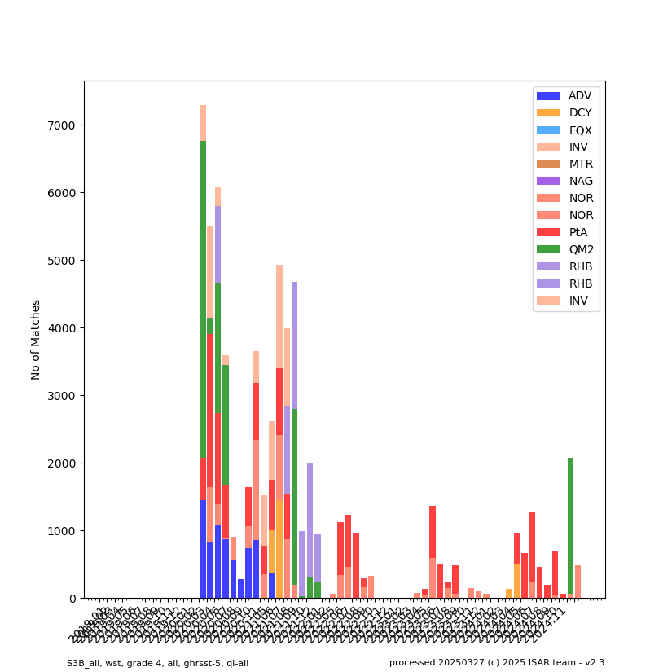
Validation results – RDAC split
2020
A
B

Slide 18
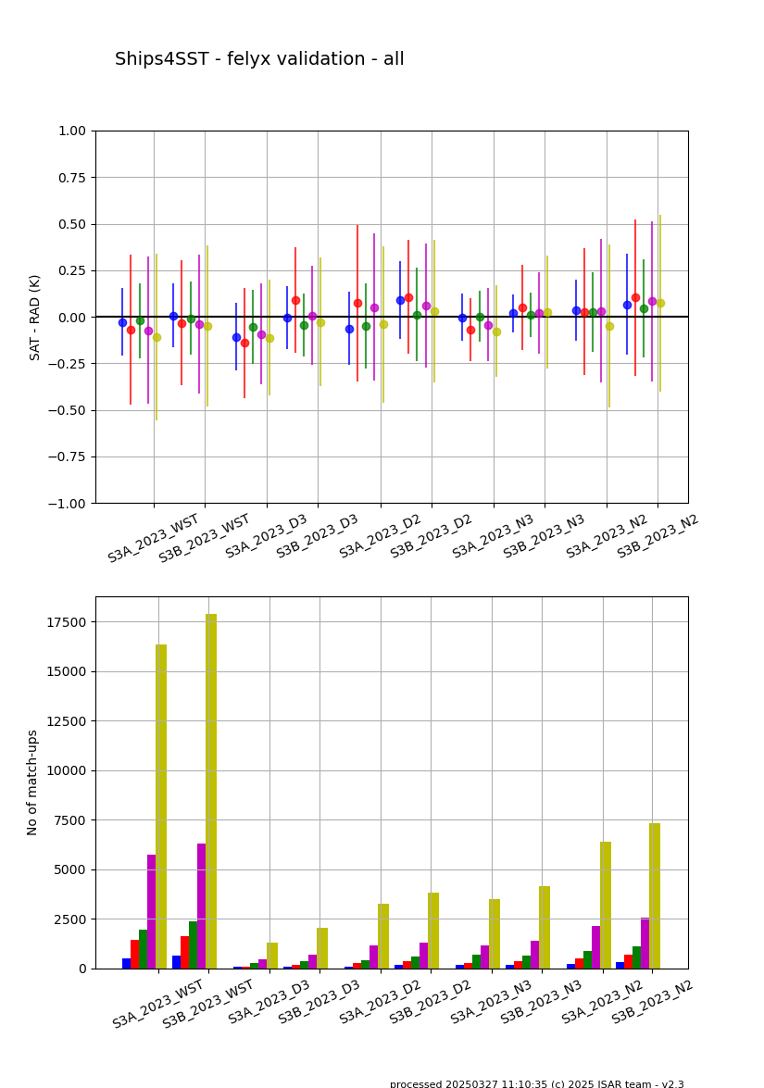
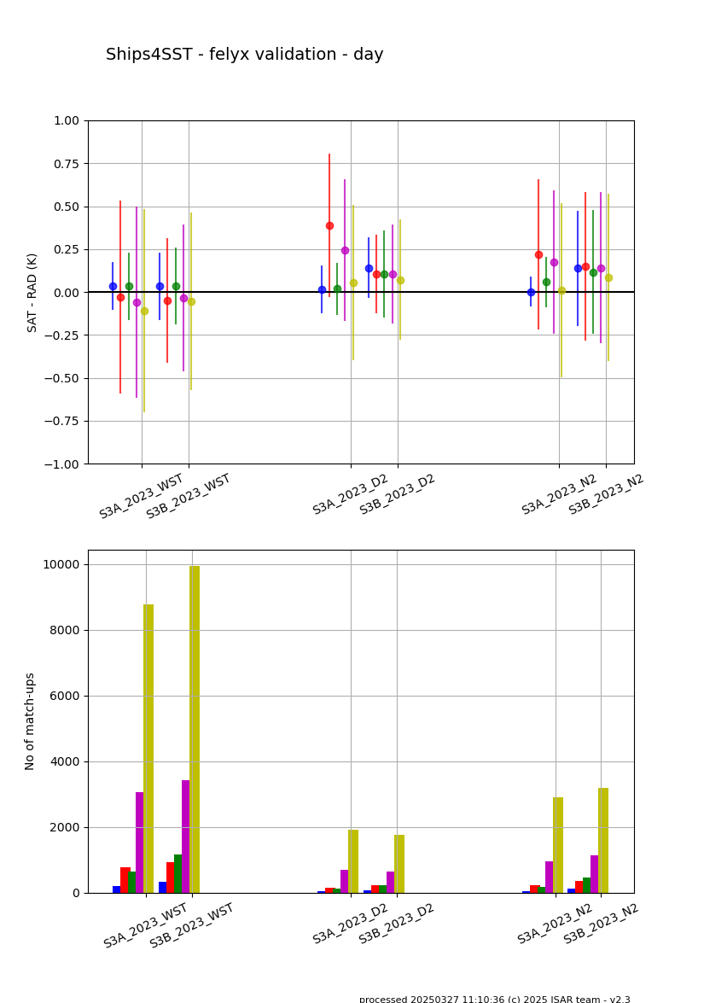
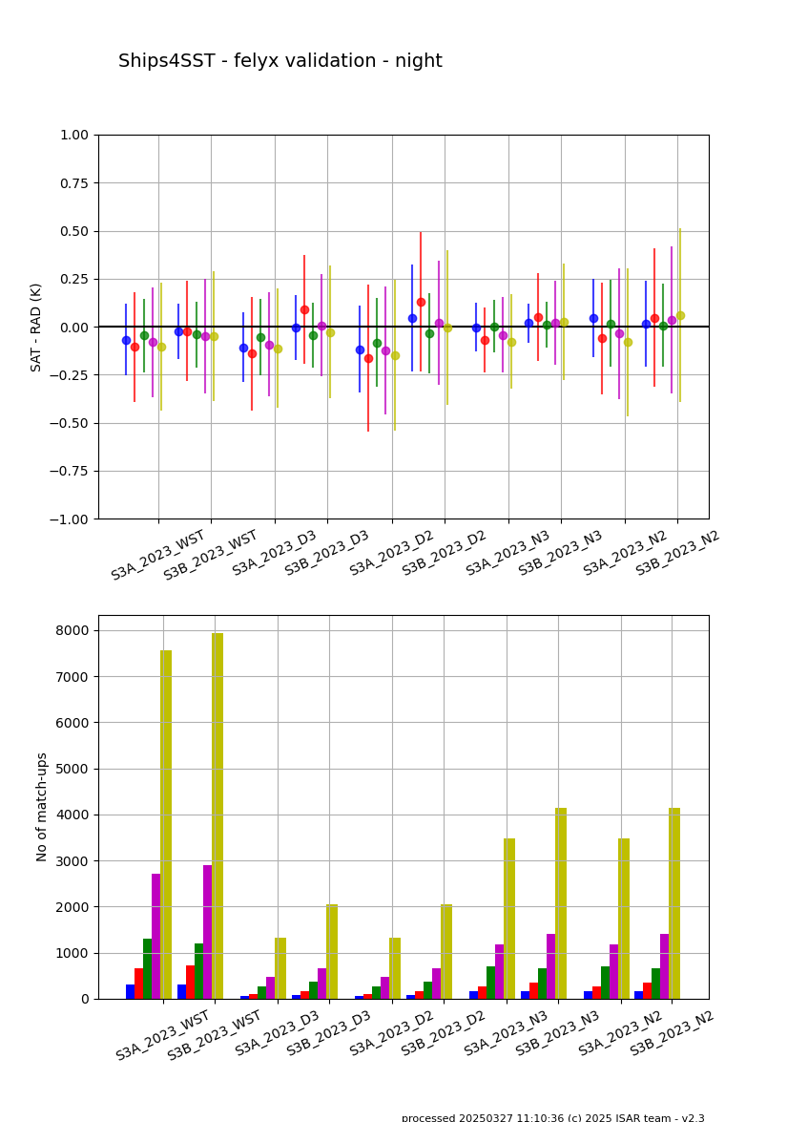
Validation results – D3,D2,N3,N2 - all
2023 - CV5, D3, N3 excluded in day time
All
Day
Night

Slide 19
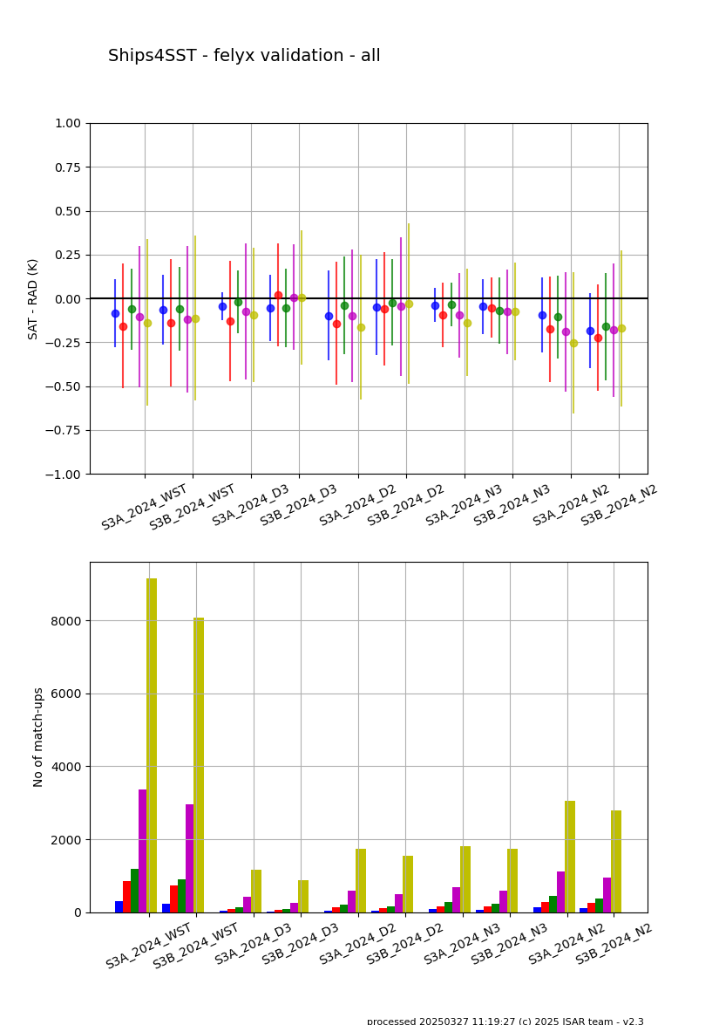
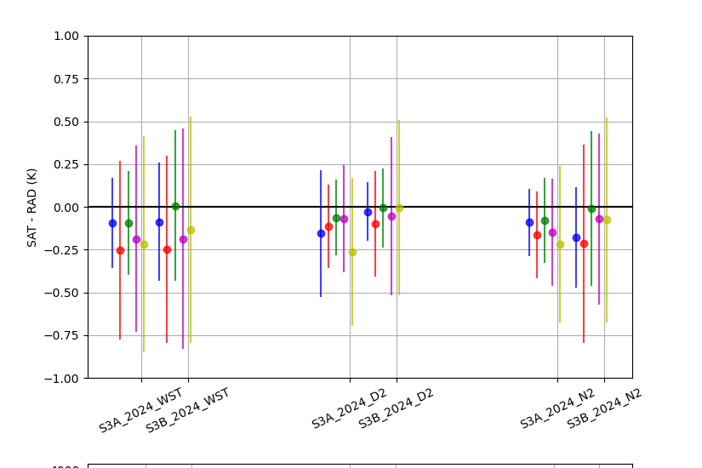
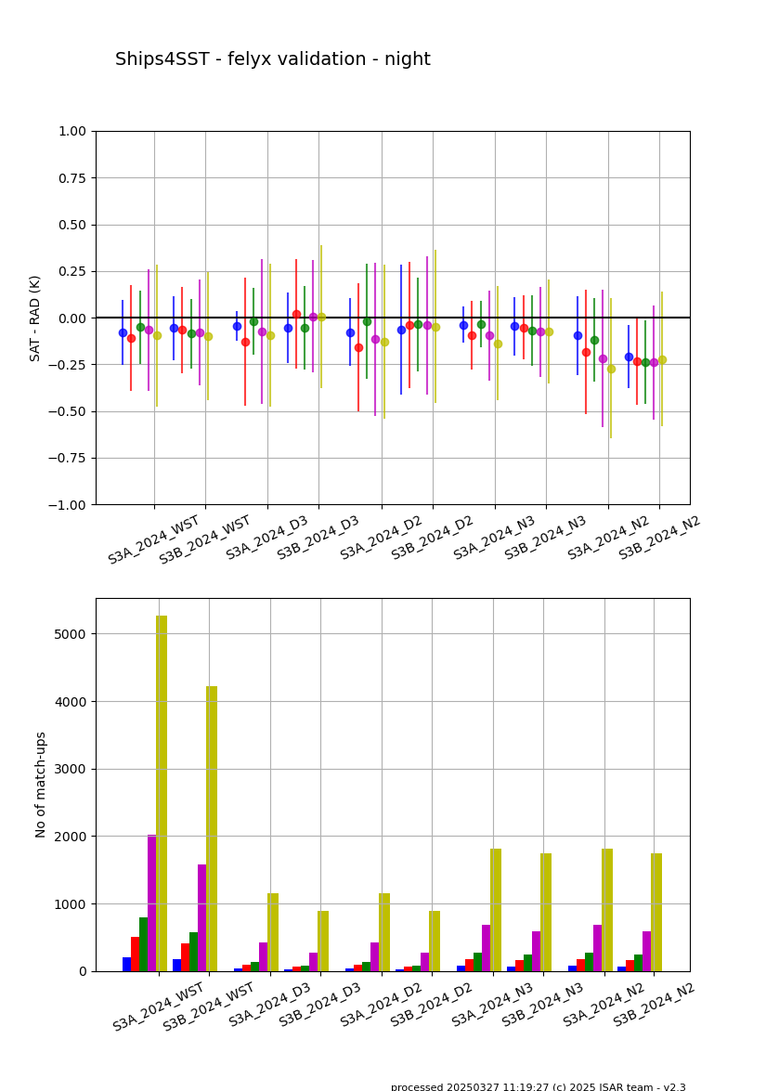
Validation results – D3,D2,N3,N2 - all
2024 - CV5, D3, N3 excluded in day time
All
Day
Night

Slide 20
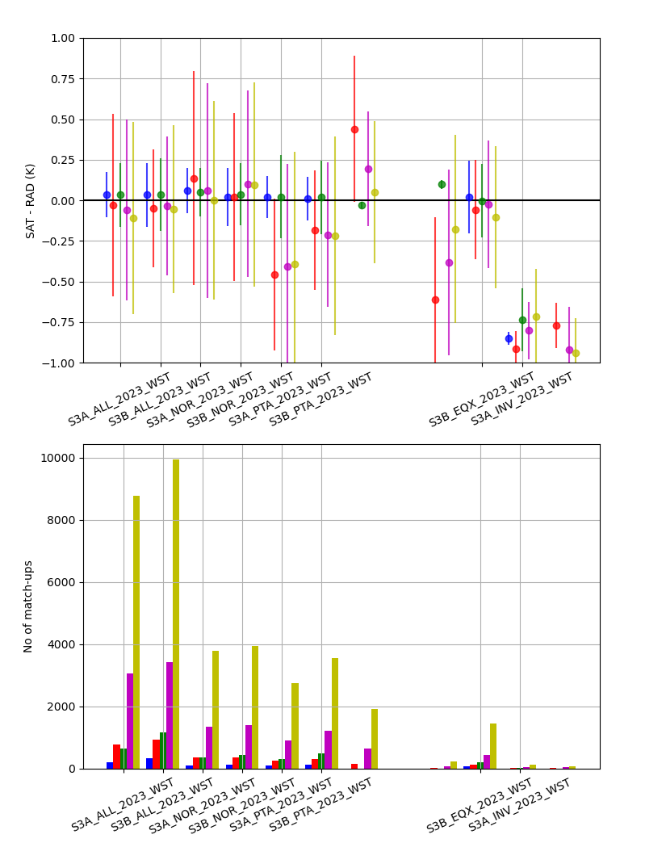
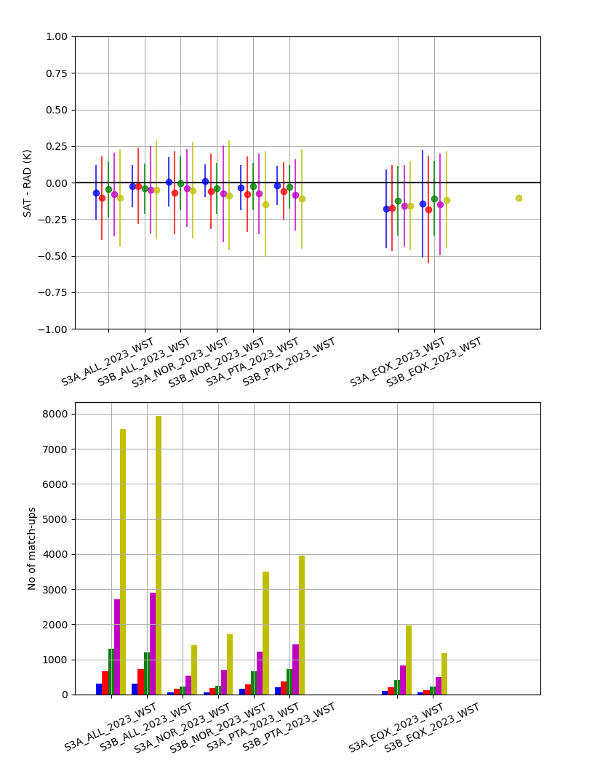
Validation results – Regional
2020 – WST CV5
Day
Night

Slide 21
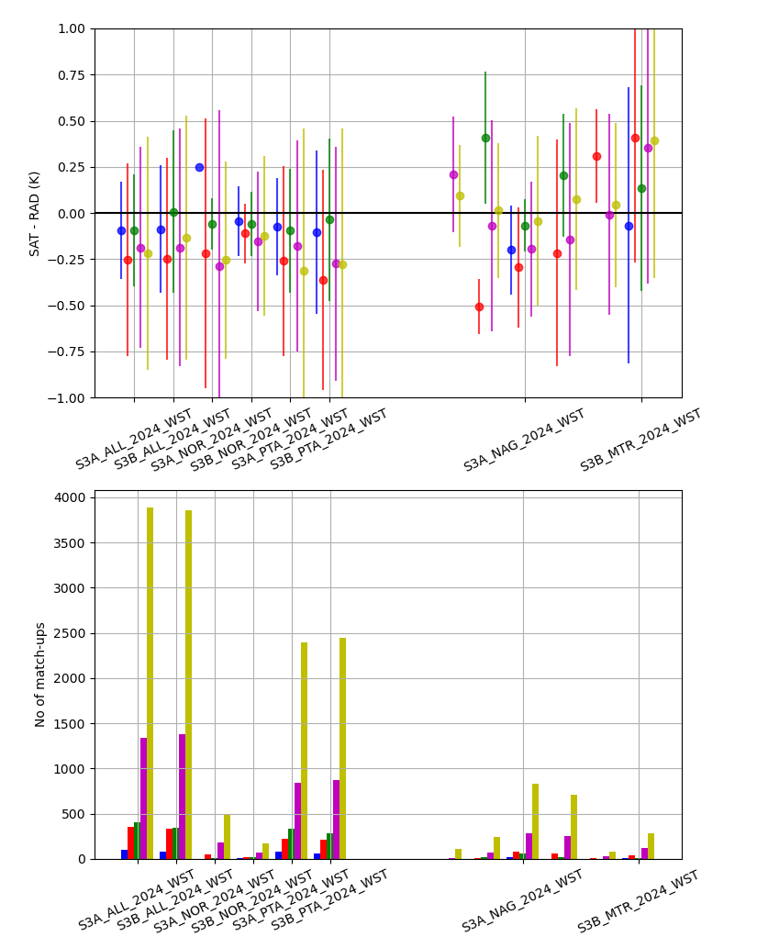
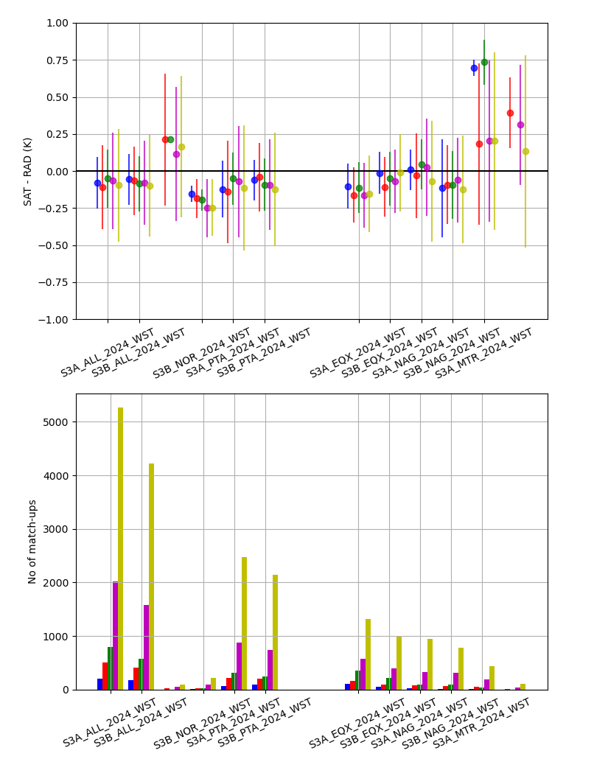
Validation results – Regional
2024 – WST CV5
Day
Night

Slide 22
Summary
Validation of SLSTR with FRM data:
  Shows very good results for SLSTR
  Virtually no mean difference at night and only a small difference at day time .
  Some mean differences, mainly SLSTR 3 B D2 data in 2020 and 2021
  RSD is lower at night than day time and comparable to AATSR .
  Some regional differences
  Lower data volume in 2021 and 2022, due to slow COVID recovery of some shipping operators
Validation data
    Felyx processing at EUMETSAT
    WST and WCT data for 2018-2024 available
    2023-2024 data
Page <number>

