Slide 1
Comparison (of shipborne radiometers) with other in situ measurements
Gary Corlett, Anne O’Carroll, Igor Tomazic
ISFRN Workshop 4th April 2025

Slide 2
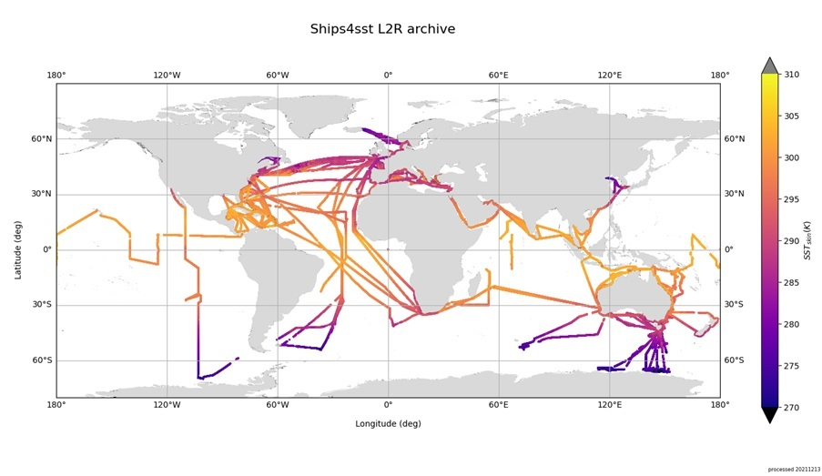
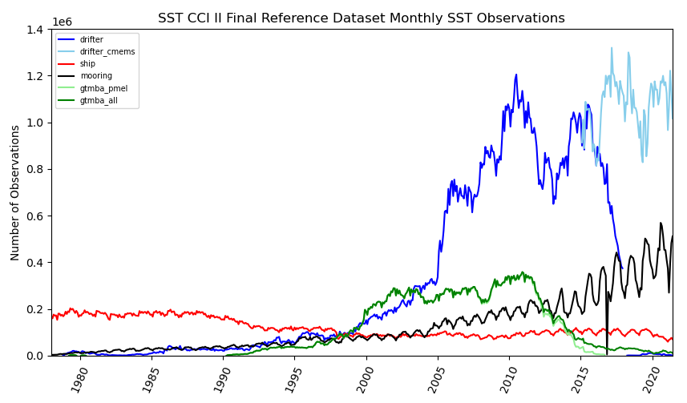
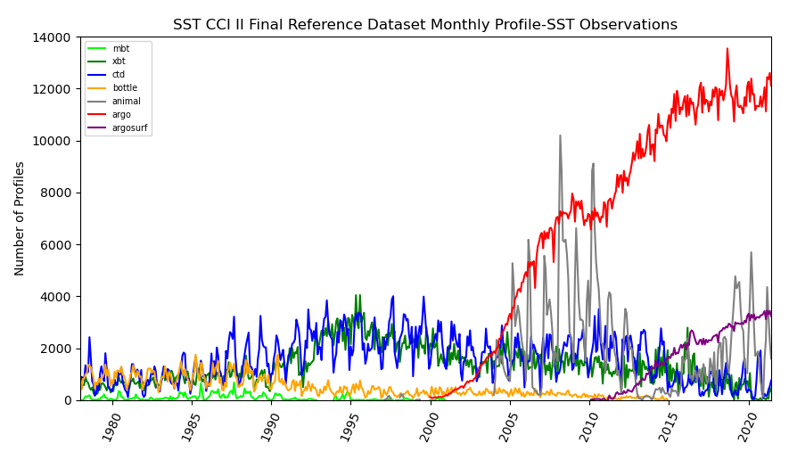
(Fiducial) Reference Measurements for satellite SST validation
Ship-borne radiometers (FRM)
Traceable to SI; SST-skin; very-high accuracy; very-poor coverage
ISFRN – International Sea Surface Temperature (SST) Fiducial Reference Measurement (FRM) Radiometer Network
Drifting buoys
Variable calibration; global data; SST-depth; good coverage in recent decade(s)
GHRSST/DBCP HRSST initiative
Copernicus TRUSTED buoys (FRM)
Argo near-surface (FRM-tbc)
Global; acceptable sampling; very-low uncertainty (calibration method to be analysed)
GTMBA
Better calibration; SST-1m; acceptable coverage (influenced by data collection);
Everything else…
https://ships4sst.org/
https://www.metoffice.gov.uk/hadobs/hadiod/sirds.html
Use both traceable and non-traceable reference data – “degree of equivalence” - > Minnett and Corlett 2012

Slide 3
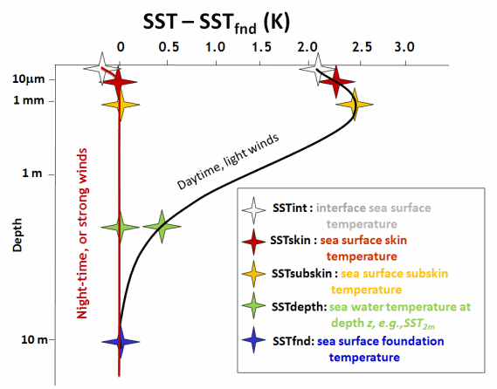
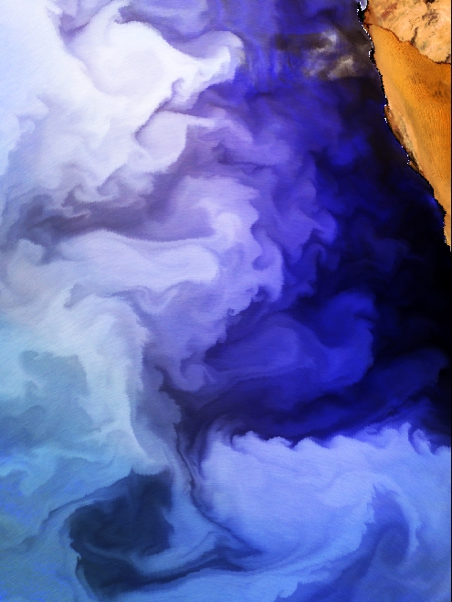
Understanding the problem
Assessment of uncertainty of satellite measurements involves comparison to a reference dataset
Create a dataset of match-up coincidences within predefined spatial and temporal limits
The bias and standard deviation calculated from such a comparison do not provide the uncertainty of each dataset individually but are the mean bias and combined uncertainty of a two-dataset comparison.
Consequently, the resulting statistics are often dominated by real changes in the SST that can occur within the predefined spatial and temporal limits.
And outliers!
Defines an upper limit for the uncertainty budget
https://www.ghrsst.org/

Slide 4
Accounting for geophysical inter-relationships
To use all available in situ data we need to estimate in situ SST-skin at time of satellite overpass
Example for drifters
Take raw drifter measurement at depth (currently assume 20 cm)
“Skin-raw”
Adjust SST-depth to SST-skin at drifter measurement time using model of skin effect and diurnal stratification
Adjust to SST-skin at satellite measurement time using same model of skin effect and diurnal stratification
“Skin-skin”
So, we not only need to validate SSTs, but also skin-to-depth models
Current model used is combination of Fairall et al. (1996) for skin effect, and Kantha and Clayson (1994) for diurnal stratification (referred to as FKC)
Validation uncertainty budget
+
clouds

Slide 5
Copernicus Sentinel 3 SST
Nominal Channel Centre | Primary Application
S7: 3.7 μm | SST Retrieval
S8: 11 μm | SST/LST Retrieval
S9: 12 μm | SST/LST Retrieval
The first Sea and Land Surface Temperature Radiometer (SLSTR) was launched on Sentinel 3A on 16th February 2016.
Sentinel 3B launched on 26 the April 2018
Dual-view self-calibrating IR radiometer following the ATSR class of sensors
SST Retrievals by radiative transfer modelling of the form:
where n is the number of channels
For SLSTR we use 2 channels during day and 3 during night
3.7 µm not used during day owing to solar contamination
We have two views, so we have four SST retrievals in total
Four Possible Retrievals:
Nadir 2-channel N2
Nadir 3-channel N3
Dual 2-channel D2
Dual 3-channel D3
WCT
This product provides sea surface temperature for all offered retrieval algorithms.
WST
This product provides the best SST at each SLSTR location in GHRSST L2P format.
SLSTR-A
Operational since 05/07/2017
SLSTR-B
Harmonized to SLSTR-A using SSES
Operational since 12/03/2019
SLSTR provides SST_{skin}
http://slstr.eumetsat.int

Slide 6
SLSTR MDBs
More details in Igor’s talk next
Main component in SLSTR SST validation
Matchups between satellite and in situ data (felyx)
Satellite: SLSTR-A/B, AVHRR-B, IASI-B, VIIRS-NPP
In situ: drifters, Argo, moored, trusted, radiometers
Contains core file (L2:WST) plus aux (L2:WCT and L1:MET/RBT)
MDB access: sftp://s3calval.eumetsat.int
Available to Sentinel-3 Validation Team (S3VT)
To become S3VT member please submit proposal (s3vt.org) and request access to SLSTR MDB
Revised radiometer dataset (ship4sstr1i1)
Repro MDB: 2016/04-2018/04 (S3A full)
NRT MDB:
2018/04 – 2018/12 (S3A; aux: no RBT)
2019/01 to 2022/12 (S3A plus S3B from March 2019; aux: no RBT)

Slide 7
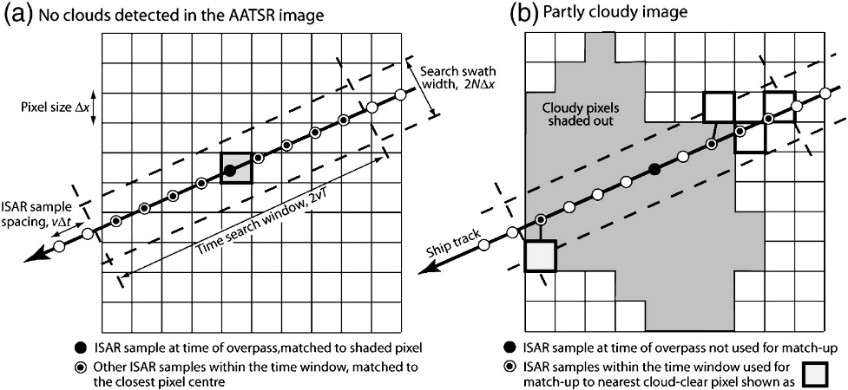
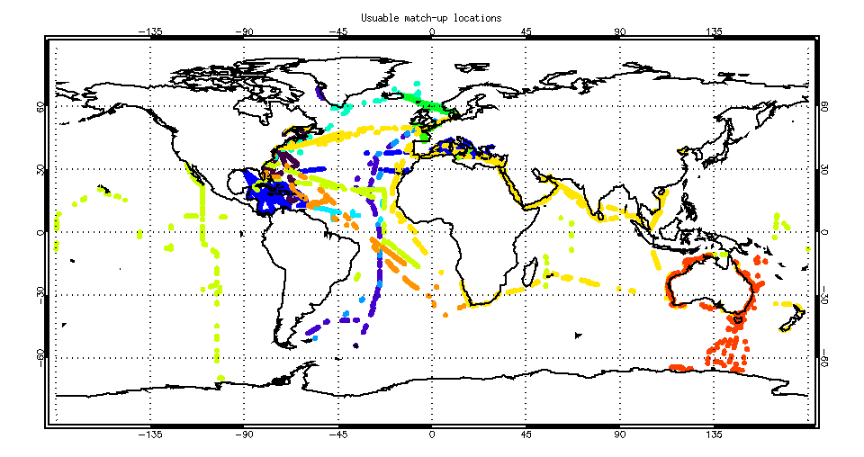
Radiometer match-ups - breakdown
Ship | All | Usable | Day | Night
Adventure | 22518 | 7539 | 1915 | 5624
Allure | 2593 | 718 | 221 | 497
DCY | 9664 | 2454 | 1335 | 1119
Equinox | 84368 | 31936 | 7935 | 24001
INV | 212 | 14 | 14 | 0
JCR | 3316 | 508 | 197 | 311
MTR | 1684 | 394 | 154 | 240
Neil Armstrong | 5911 | 674 | 236 | 438
Norroena | 24052 | 3491 | 1416 | 2075
Norrona | 73549 | 10382 | 3681 | 6701
PtA | 180179 | 47113 | 17651 | 29462
R/V Minerva Uno | 1067 | 423 | 227 | 196
R/V Ronald H. Brown | 19121 | 4483 | 1748 | 2735
RMS Queen Mary 2 | 78048 | 19597 | 5422 | 14175
Ronald H. Brown | 7179 | 2133 | 809 | 1324
VLMJ | 38700 | 8104 | 3607 | 4497
Wimmer et al. 2012
Usable = Valid SLSTR SST, match-up within +/- 8 hours, in situ QL GE 1

Slide 8
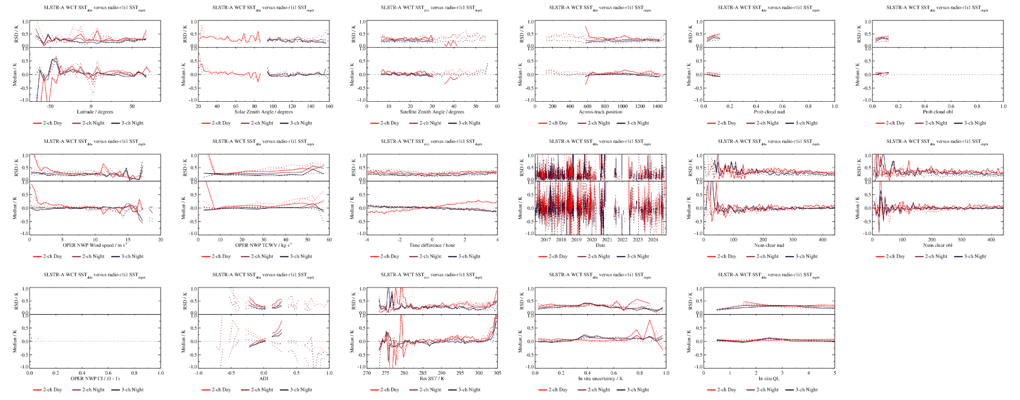
The Validation Space – dependence – radiometers
No FKC adjustments applied

Slide 9
The Validation Space – dependence - radiometers
FKC adjustments applied

Slide 10
The Validation Space – spatial
N2 day
D2 day
N2 night
N3 night
D2 night
D3 night
FKC adjustments applied

Slide 11
The Validation Space – histograms / uncertainties
N2 day
D2 day
N2 night
N3 night
D2 night
D3 night
FKC adjustments applied

Slide 12
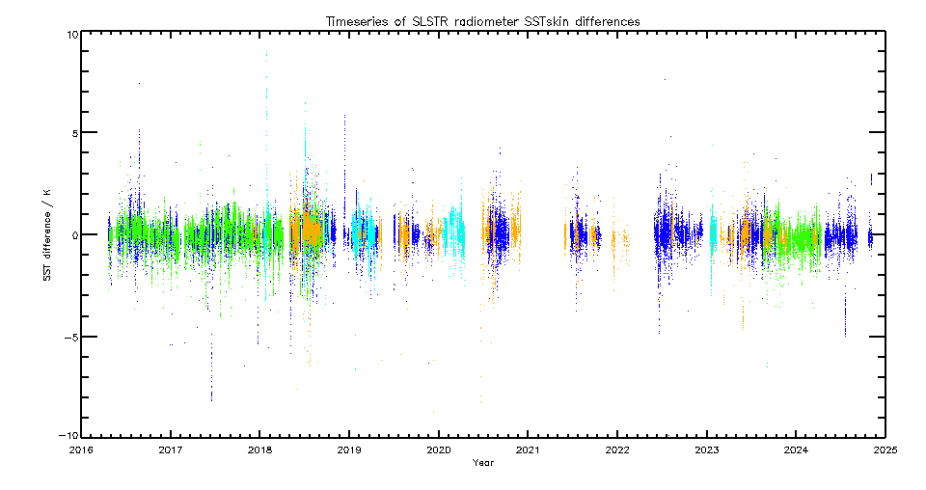
Radiometer – Stability Analysis
First attempt at applying CDAF to radiometers with longest timeseries
PtA; QM2; Equinox, Norroena
Notable limitations still to be overcome: Gaps; seasonality; match-up methodology; SLSTR cloud mask

Slide 13
Summary
Satellite radiometers such as SLSTR can provide SSTskin within an uncertainty less than 0.1 K
SLSTR does provide a measure of SSTskin
Confirmed through independent validation using data from multiple in situ sources / depths
Demonstrating this requires a thorough understanding of the physics of the atmosphere and the upper ocean
Multiple measurement sources, models and methods are needed
New generation in situ (FRM) are required to support SSTskin validation
To identify geophysical effects from retrieval effects
Continuity of SSTskin FRM is essential to maintain long-term SST records
As is continuity of drifter, Argo and mooring records as well – we need an integrated observing system
Stability assessment of long-term radiometer deployments ongoing
Consistency of FRM data, especially metadata, is essential

Slide 14
Thank you!
Questions are welcome.
Acknowledgments:
Chris Merchant, Owen Embury, Chris Atkinson, Jean-Francois Piolle,
and of course, all the radiometer PIs!

