Slide 1
A next generation in-situ radiometer
Arrow Lee, Tim Nightingale and Werenfrid Wimmer

Slide 2
Outline
Background to next-generation radiometer study
Summary of requirements
Design features

Slide 3
Introduction
CCN to current FRM4SST contract: “WP80: Case study for a next generation radiometer”
We’re tasked to:
  Consider the basis for a new generation of in situ radiometers,
  Concentrate on validation activities,
  Survey different measurement approaches, particularly infrared broadband and spectro-radiometry and microwave radiometry,
  Review experience with existing instruments,
  Propose an outline design for a new instrument.
We also want to give more attention to issues such as:
  Manufacturability
  Ease of optical alignment
  Maintainability
  Ease of deployment
  Electrical and mechanical interfaces

Slide 4
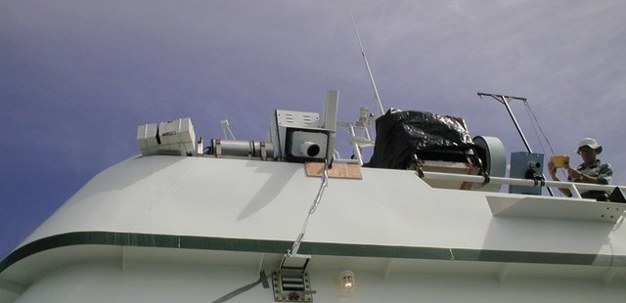
The usual suspects
From left to right: SISTeR, ISAR, CIRIMS, M-AERI and DAR011 on the R/V F.G. Walton Smith in 2001

Slide 5
Requirements
SST systematic uncertainty < 100 mK 1σ (50 mK goal)
  Includes retrieval, ancillary data, model uncertainties
  BT systematic uncertainty tighter
Clear traceability route for SST measurements
Autonomous operation
Straightforward use and maintenance

Slide 6
Questions
Thermal infrared / microwave?
  Thermal infrared:
    Excellent calibration sources (internal and external)
    High sensitivity of basic sea radiance measurement to SST
    Well controlled beam pattern
    Close to ideal calibration scheme
  Microwave:
    Direct radiance measurements (including polarisation) in bands comparable to microwave satellite instruments, such as CIMR
    Correct skin depth for microwave intercomparisons

Slide 7
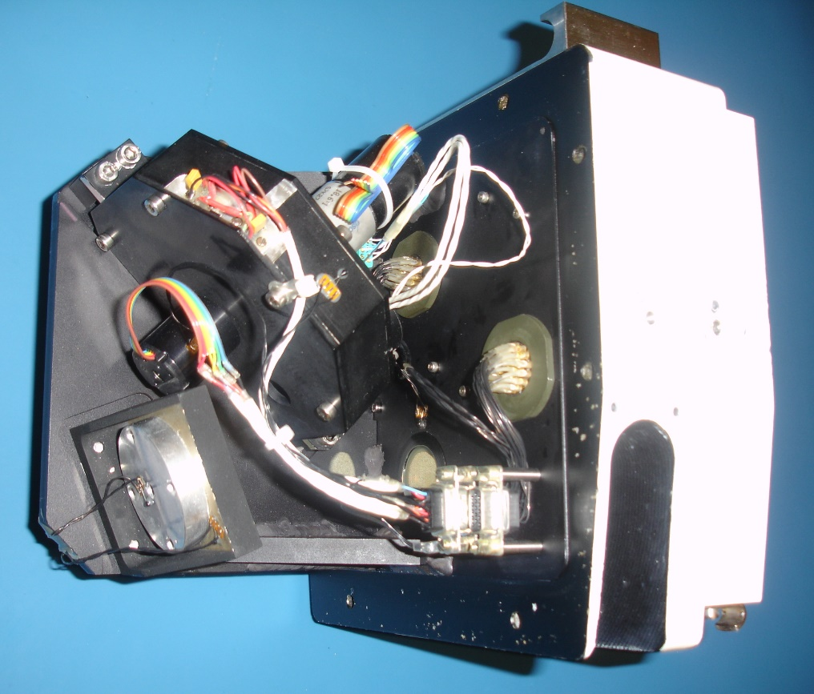
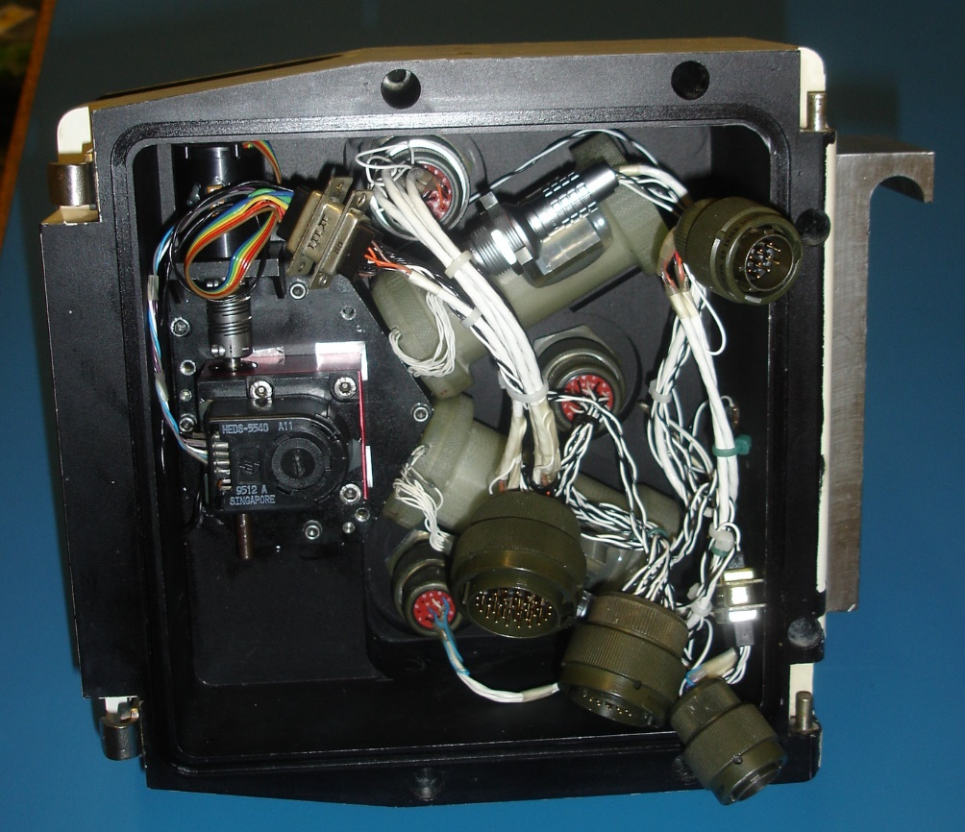
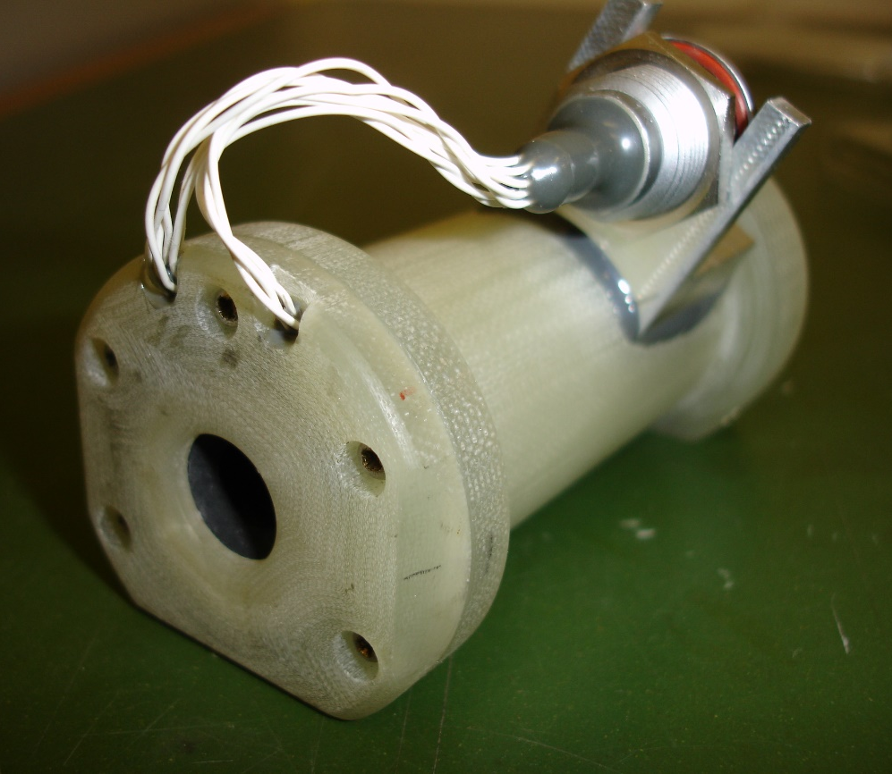
Questions
Self-calibrating radiometer / nulling radiometer / other?
  Self-calibrating radiometer
    Robust, frequent end-to-end calibration of optical chain
    Possibility for self-traceability through on-board calibration targets
    Easily adapted for multiple viewing angles if equipped with scan mirror
  Nulling radiometer
    Black body compromises, as servo-ed to scene temperature
    Not ideal for sky measurements

Slide 8
Questions
Imaging / non-imaging?
  Imaging
    Large exit aperture near to aperture plane (distant object plane)
    Fast sampling to avoid along-track smearing (poor noise performance)
    Small detector sizes to resolve image (poor noise performance)
    Likely to need cooled detectors for TIR
  Non-imaging
    Small exit aperture if placed at object plane (but divergent beam)
    Simple detector chain – chopping and synchronous detection possible
    Limited spatial resolution (t_{int} * v_{ship})
    Uncooled detector will give decent noise performance (30 mK @ 1 s)

Slide 9
Questions
Single band / multiple bands / spectrometer?
  Single band
    Fine for SST but limited flexibility
  Multiple bands
    Increased complexity
    Possibilities to validate SST retrieval models
    Possibilities to retrieve other quantities (e.g. air temperature)
  Spectrometer
    Highest complexity
    Michelson / static FTS / grating / other?

Slide 10
Questions
Which band(s)?
  3.7 µm
    High SST sensitivity (dB/dT) but few photons
  7.7 µm
    Lower atmospheric transmission, lower sensitivity to (distant) sky radiances
  10.8 µm
    Peak of Planck function
    Highest sea surface emissivity
  13 µm
    CO₂ band for air temperature sounding?

Slide 11
Questions
SST retrieval technique
  Sea + sky view
    A priori sea surface emissivity?
    Atmospheric line nulling?

Slide 12
Questions
Other features?
  What would you like to see in a new instrument?

